Slide 1
Azure Times #142
November 25, 2024

Slide 2
Networking

Slide 3
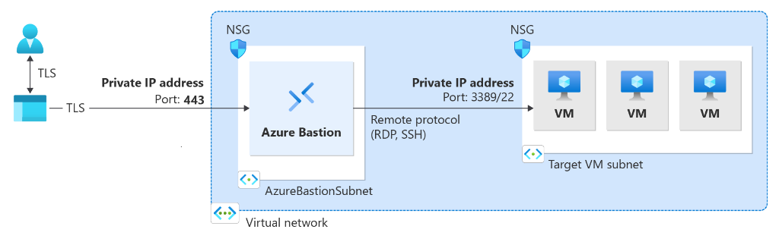
Networking Updates
GA: Azure Bastion Premium
Azure Bastion Premium is a new SKU to target customers handling highly sensitive virtual machine workloads. Its mission is to offer enhanced security features that ensure customer virtual machines are connected securely and to monitor VMs for any anomalies that may arise. First set of features will focus on ensuring private connectivity and graphical recordings of virtual machines connected through Bastion.
With the new Azure Bastion Premium SKU, it is possible to configure the following features:
Record all virtual machine sessions that are connected via a session-recording Bastion - When the Azure Bastion Session recording feature is enabled, it is possible to record the graphical sessions for connections made to virtual machines (RDP and SSH) via the bastion host. After the session is closed or disconnected, recorded sessions are stored in a blob container within storage account (via SAS URL). When a session is disconnected, it is possible to access and view recorded sessions in the Azure portal on the Session Recording page.
Session recording isn't available via native client at this time.
Session recording supports one container/storage account at a time.
When session recording is enabled on a bastion host, Bastion records ALL sessions that go through the recording-enabled bastion host.
Connect to Bastion via a private endpoint
Private-only Bastion deployments lock down workloads end-to-end by creating a non-internet routable deployment of Bastion that allows only private IP address access. Private-only Bastion deployments don't allow connections to the bastion host via public IP address. In contrast, a regular Azure Bastion deployment allows users to connect to the bastion host using a public IP address.

Slide 4
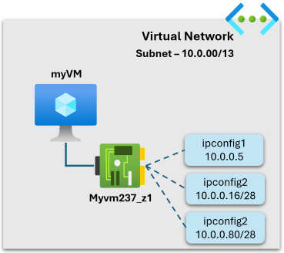
Networking Updates
PP: Azure Virtual Network now supports configuration of private IP address blocks on network interfaces
Azure Virtual Network now supports up to 16X more private IP addresses with configuration of blocks of private IP addresses on a network interface.
Network interfaces in Azure support configuration of one primary and multiple secondary IP configurations. This capability enables to configure a /28 CIDR block of private IPv4 addresses for secondary IP configurations, giving you 16 usable IP addresses per IP configuration. So, the total number of usable IP addresses in a virtual network is now 16X.
This capability is particularly usable for scenarios where customers need to deploy a large number of K8s containers in a virtual network and be able to route between VMs and K8s containers seamlessly.
Public Preview: Copilot in Azure embedded experience for Azure Firewall integration in Security Copilot
The Azure Firewall integration in Security Copilot helps analysts perform detailed investigations of the malicious traffic intercepted by the IDPS feature of their firewalls across their entire fleet using natural language questions. In an announcement earlier this year, these capabilities were launched on the Security Copilot portal and now are being integrated even more closely with Azure Firewall. The following capabilities can now be queried via the Copilot in Azure experience directly on the Azure portal where customers regularly interact with their Azure Firewalls:
Retrieve the top IDPS signature hits for an Azure Firewall
Enrich the threat profile of an IDPS signature beyond log information
Look for a given IDPS signature across your tenant, subscription, or resource group
Generate recommendations to secure your environment using Azure Firewall's IDPS feature

Slide 5
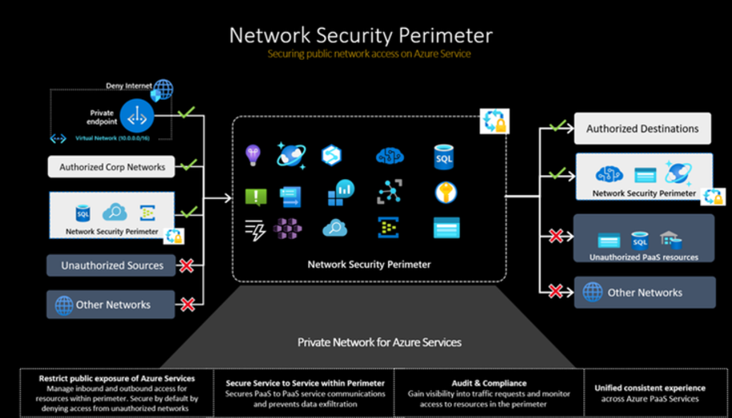
Networking Updates
Public Preview: Network security perimeter
Azure Monitor services now extend support to Network Security Perimeter (NSP) features, enabling Azure PaaS resources to communicate securely within a trusted boundary. The integration of NSP features in Azure Monitor services enhances security and monitoring capabilities across 6 Azure cloud regions (East US, East US 2, North Central US, South Central US, West US, West US 2). These features are specifically designed to bolster the security and monitoring of customers' networks. Using NSP features in Azure Monitor services, customers can create a secure and isolated network environment, which is important in today's dynamic threat landscape.
With network security perimeter, administrators can:
Create a secure boundary around PaaS resources.
Prevent data exfiltration by associating PaaS resources to the perimeter.
Enable access rules to grant access outside the secure perimeter.
Manage access rules for all the PaaS resources within the network security perimeter in a single pane of glass.
Enable diagnostic settings to generate access logs of PaaS resources within the perimeter for Audit and Compliance.
Allow private endpoint traffic without additional access rules.

Slide 6
Networking Updates
Public Preview: Fallback to Internet on Private DNS Zone
New feature which unblocks adoption of a fully managed solution for Network Isolation and simplifies scenarios with Private Link and Private DNS. This feature enables public recursion to occur in the event of receiving an authoritative NXDOMAIN response from Private DNS Zones. Customers can now rely on a fully managed native solution without using IaaS based DNS servers to unblock Private Link and Private DNS adoption.
An NXDOMAIN (RCODE3) response means the (Private Link) queried domain name doesn't exist. This negative answer typically prevents resolvers from retrying the query until the cached negative answer expires.
When the NxDomainRedirect resolution policy is enabled on a virtual network link, the Azure recursive resolver retries the query. The resolver uses the public endpoint QNAME as the query label each time an NXDOMAIN response is received from PrivateEdge for that private zone scope.
This policy is only available for Private DNS zones associated to Private Link resources.
The ResolutionPolicy parameter only accepts Default or NxDomainRedirect as possible values.
PP: DNS Security Policy
This new feature brings the visibility of DNS traffic at the VNET level with the flexibility to send logs to storage account, log analytics workspace, or event hubs. The private preview also includes DNS filtering based on lists of domains for allow/block actions. GA will include threat intel feed based on known malicious domains sourced by MSRC and other security researchers.
DNS security policy offers the ability to filter DNS queries at the virtual network (VNET) level. It is now possible to allow, alert, or block name resolution of known or malicious domains and gain insight into your DNS traffic. Detailed DNS logs can be sent to a storage account, log analytics workspace, or event hubs.
A DNS security policy has the following associated elements and properties:
Location: A security policy can only apply to VNets in the same region.
DNS traffic rules: Rules that allow, block, or alert based on priority and domain lists. Rules can be enabled or disabled.
Virtual network links: You can link one security policy per VNet. A security policy can be associated to multiple VNets.
DNS domain lists: Location-based lists of DNS domains.

Slide 7
Networking Updates
Public Preview: Azure DNS Support for DNSSEC
This new feature provides an additional layer of security to domain names, ensuring the integrity and authenticity of your DNS data.
DNSSEC is a suite of extensions to DNS that adds security to the domain name system. It helps protect against certain types of attacks, such as cache poisoning and man-in-the-middle attacks, by enabling DNS responses to be verified for authenticity.
Key Benefits of DNSSEC on Azure DNS
Enhanced Security: DNSSEC helps prevent attackers from manipulating or poisoning DNS responses, ensuring that users are directed to the correct websites.
Data Integrity: By signing DNS data, DNSSEC ensures that the information received from a DNS query has not been altered in transit.
Trust and Authenticity: DNSSEC provides a chain of trust from the root DNS servers down to your domain, verifying the authenticity of DNS data.

Slide 8
Security & Identity

Slide 9
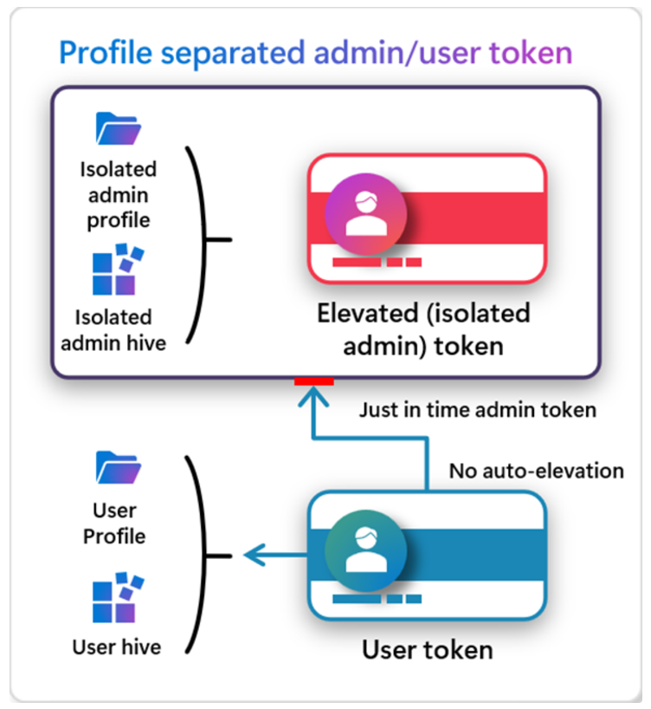
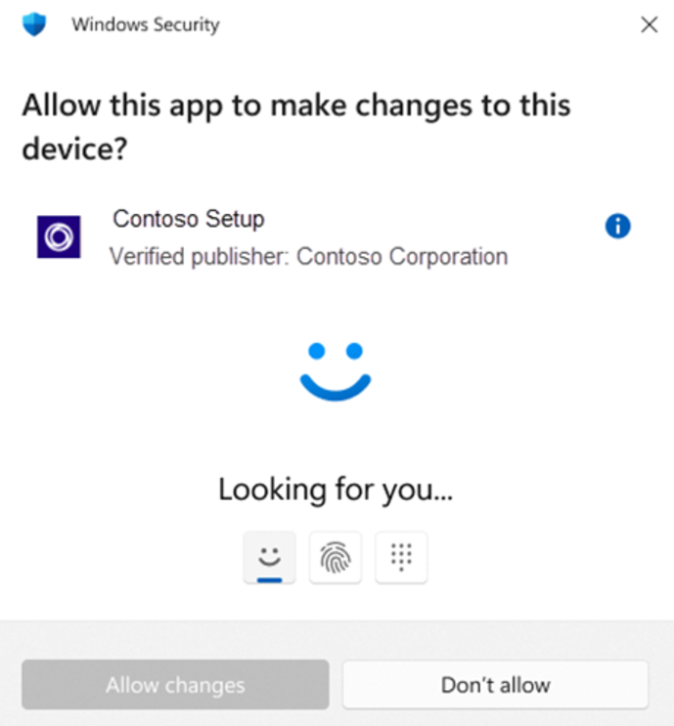
Security & Identity Updates
Administrator protection on Windows 11
Administrator protection aims to protect users while still allowing them to perform necessary functions with just-in-time administrator privileges. Administrator protection requires that a user verify their identity with Windows Hello integrated authentication before allowing any action that requires administrator privileges. These actions include installing software, changing system settings like the time or the registry, and accessing sensitive data. Administrator protection minimizes the risk of the user making a system-level change by mistake, and, more importantly, helps prevent malware from making silent changes to the system without the user knowing.

Slide 10
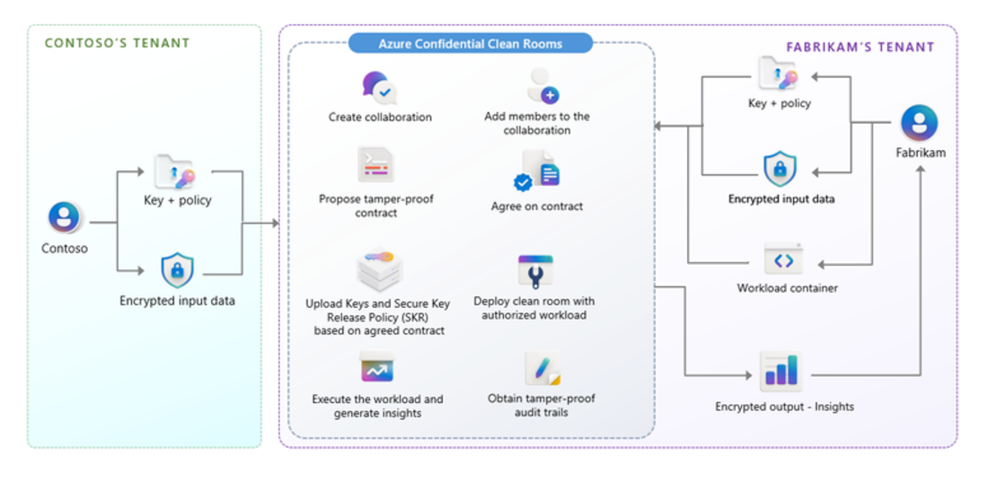
Security & Identity Updates
Private Preview: Azure Confidential Clean Rooms
Microsoft is announcing the gated preview of Azure Confidential Clean Rooms, a cutting-edge solution designed for organizations that require secure multi-party data collaboration. With Confidential Clean Rooms, it is possible to share privacy sensitive data such as personally identifiable information (PII), protected health information (PHI) and cryptographic secrets confidently, thanks to robust trust guarantees that safeguard data throughout its lifecycle from other collaborators and from Azure operators. This secure data sharing is powered by confidential computing, which protects data in-use by performing computations in hardware-based, attested Trusted Execution Environments (TEEs). These TEEs help prevent unauthorized access or modification of application code and data during use.
Hotpatch for client comes to Windows 11 Enterprise
MS announced hotpatch updates for Windows 11 Enterprise, version 24H2. With hotpatch updates, it is possible to quickly take measures to help protect organization from the evolving landscape of cyberattacks, while minimizing user disruptions. Hotpatching represents a significant advancement in our journey to help make you and everyone who uses Windows more secure and productive.
The first month of each quarter of the calendar year (i.e. January, April, July, and October), devices install the standard monthly security update and restart. This cumulative update contains the latest security fixes, new features, and enhancements. The following two months, devices are offered hotpatch updates, which include only security updates and install without the need to restart. At the start of the next quarter, the cycle repeats.

Slide 11
Management & Governance

Slide 12
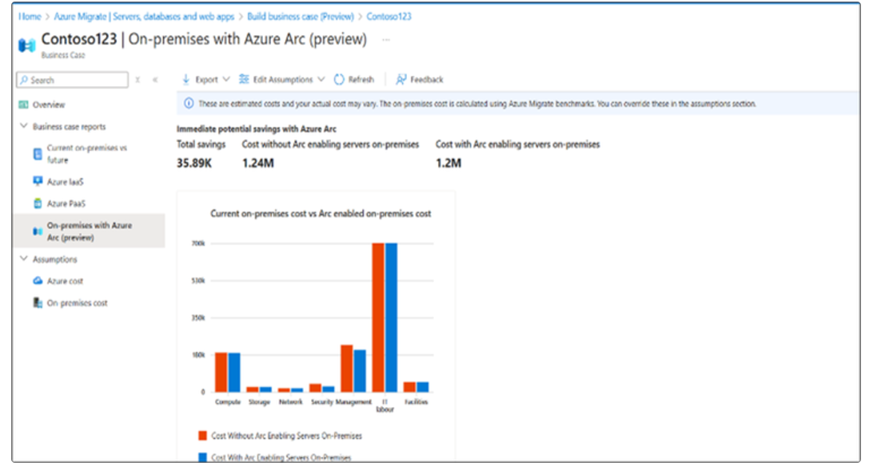
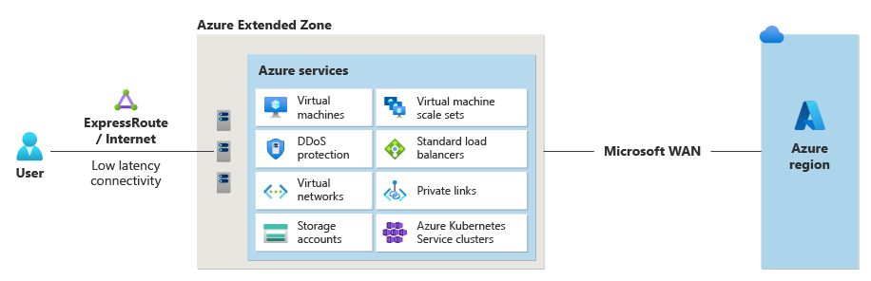
Management & Governance Updates
GA: Los Angeles – Azure Extended Zones
Azure Extended Zones are small-footprint extensions of Azure placed in metros, industry centers, or a specific jurisdiction to serve low latency and data residency workloads. They support virtual machines (VMs), containers, storage, and a selected set of Azure services and can run latency-sensitive and throughput-intensive applications close to end users and within approved data residency boundaries.
Azure Migrate Updates
Business case for Arc – it is now possible to compare estimated current on-premises TCO with the estimated TCO of on-premises estate with Azure Arc, visualize the cost savings and other benefits of using Azure security (Microsoft Defender for Cloud) and management tools (Azure Monitor and Azure Update Manager) via Azure Arc for on-premises servers, and see the licensing benefits of Extended Security Updates (ESUs) enabled by Azure Arc, as well as SQL Pay-As-You-Go via Azure Arc-enabled SQL Server.
Arc onboarding – The Azure Migrate inventory now integrates with Azure Arc, allowing customers to identify which of their discovered machines are already Arc-enabled and onboard those that are not, directly from the Azure Migrate portal. This integration provides a seamless experience, offering enhanced control and visibility over the migration process while managing the remaining on-premises inventory.

Slide 13
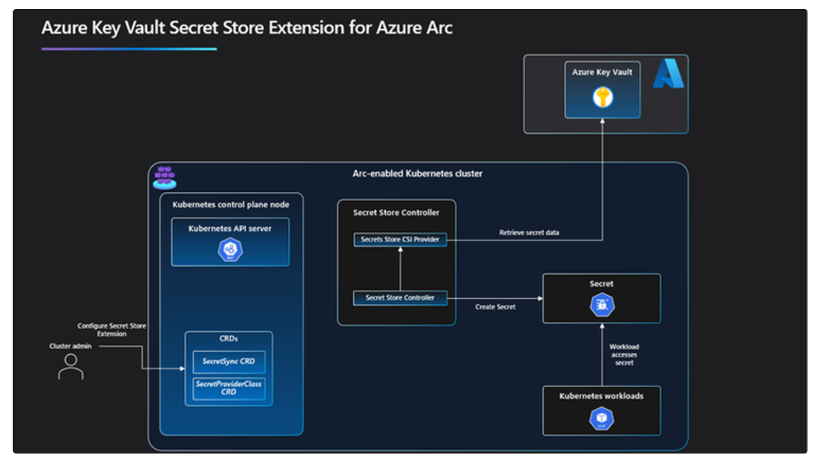
Management & Governance Updates
Public Preview of Azure Key Vault Secret Store Extension
MS announced the Public Preview of Azure Key Vault Secret Store Extension (SSE) for Arc-enabled on-premises Kubernetes, including clusters that connect yourself and AKS managed clusters. SSE automatically synchronizes secrets from an Azure Key Vault to the on-premises cluster for offline access. This means it is now possible to use Azure Key Vault to store, maintain, and rotate secrets, even when running Kubernetes cluster in a semi-disconnected state.
Benefits:
Offline Access
Standard K8s Secret Access
Security
Announcing General Availability: Windows Server Management enabled by Azure Arc
Azure's expanded set of modern server management capabilities including Azure Update Manager, Machine Configuration, and Change Tracking and Inventory are now available for free to customers enrolled in Windows Server Pay as you Go or with active Software Assurance coverage for their Azure Arc-enabled servers.
Windows Server Management enabled by Azure Arc offers customers with Windows Server licenses that have active Software Assurances or Windows Server licenses that are active subscription licenses the following key benefits:
Azure Update Manager
Azure Change Tracking and Inventory
Azure Machine Configuration
Windows Admin Center in Azure for Arc
Remote Support
Network HUD
Best Practices Assessment
Azure Site Recovery (Configuration Only)

Slide 14
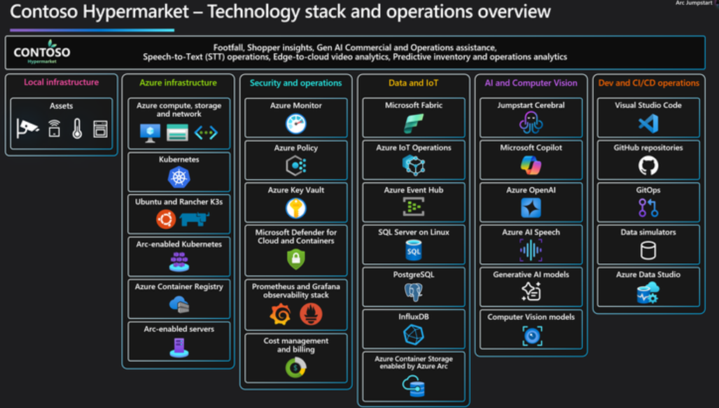

Management & Governance Updates
Announcing Jumpstart Agora "Contoso Hypermarket"
This scenario demonstrates how Contoso leverages AI-driven shopper analytics for real-time customer insights, enabling smarter marketing, optimized product placement, and efficient inventory management. With AI and IoT solutions for real-time error detection and automated checkout monitoring, Contoso Hypermarket offers a powerful model for improving retail operations and customer experiences.
Introducing Jumpstart Cerebral
MS introduced Jumpstart Cerebral, an AI framework designed to enhance decision-making and problem-solving across industries. Powered by Azure OpenAI, Cerebral enables real-time insights and natural language interactions at the edge.

Slide 15
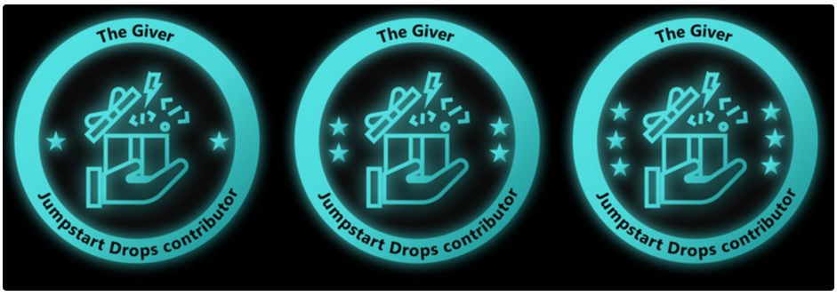
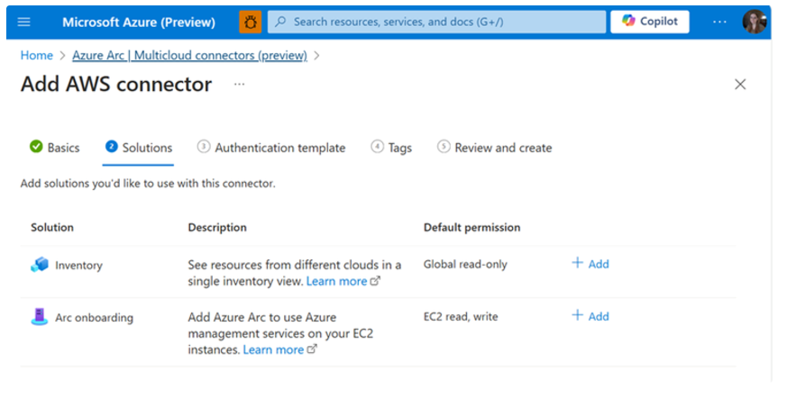
Management & Governance Updates
GA: Jumpstart Drop
Jumpstart Drops has grown into a thriving resource, with dozens of unique Drops, hundreds of downloads, and thousands of views contributed by our growing community.
This launch introduces exciting new features, including:
Drops Creation Wizard for seamless contributions
Enhanced labeling for improved navigation
Various UI enhancements inspired
To celebrate contributors who have gone above and beyond, we are also introducing "The Giver", a new badge in the Jumpstart Community Badges program, recognizing exceptional contributions that go above and beyond.
Generally Available: Multicloud connector enabled by Azure Arc
MS announced that the Multicloud connector is now generally available for customers for AWS environments. With the Multicloud connector, it is now possible to easily connect AWS accounts to Azure with the following capabilities:
Inventory: Get an up-to-date, comprehensive view of cloud assets across different cloud providers. Now supporting over 30+ AWS services (EC2, EKS, S3, Lambda, and more), gain insights into Azure & AWS environments in a single pane of glass. The agentless inventory solution will periodically scan AWS environment, project the discovered resources in AWS as Azure resources, including all of the AWS metadata like AWS tags.
Azure Arc onboarding: Automatically Arc-enable existing and future EC2 instances to leverage Azure and Microsoft services, like Azure Monitor and Microsoft Defender. Through the multicloud connector, the Azure Arc agent will be automatically installed for machines that meet the prerequisites.

Slide 16
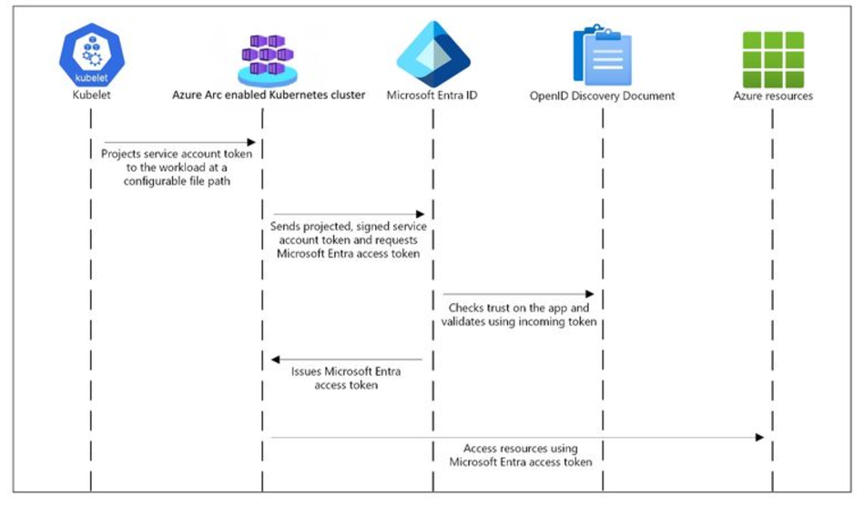
Management & Governance Updates
AKS enabled by Azure Arc - New Capabilities and Expanded Workload Support
Azure IoT Operations
Azure Container Storage - enabled by Azure Arc
Azure Key Vault Secret Store extension for Kubernetes
Azure Monitor Pipeline
Arc Workload Identity Federation
Arc Gateway
Azure AI Video Indexer - enabled by Azure Arc
MetalLB - Azure Arc Extension
GPUs for AI Workloads
Arc-enabled Azure Machine Learning:
Arc-enabled Video Indexer:
Infrastructure as Code (IaC) with Terraform
Anti-affinity, Pod CIDR, Taints/Labels
Announcing Public Preview of Workload Identity Federation for Azure Arc enabled Kubernetes clusters
Workload identity support for Azure Arc enabled Kubernetes cluster allows applications running in Kubernetes clusters to securely access Azure resources like Azure Key vaults, Azure blob storage without the hassle of managing secrets.
The workload identity feature integrates with Kubernetes' native capabilities to federate with external identity providers. Specifically, it uses Service Account Token Volume Projection to enable application pods to obtain a Kubernetes identity. A user-assigned managed identity can be configured to trust tokens from a Kubernetes cluster (external IDP provider).

Slide 17
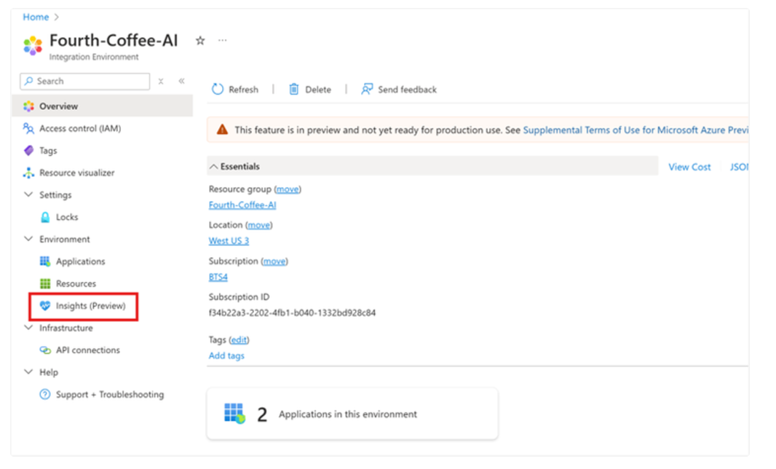
Management & Governance Updates
Integration Environment and Application Monitoring enhancements
Integration Environment allows to monitor Azure Integration Services, including Azure Logic Apps, Azure Service Bus, and Azure API Management (APIM), from a single pane of glass.
Single pane view into the Health of All Applications in Integration Environment
End-to-End Message Tracing Across AIS Resources
At-Scale Monitoring for Logic Apps
Improved Browsing Experience
Public Preview of Windows Admin Center v2410
This 2410 preview release improves upon the last Windows Admin Center 2410 Public Preview build that was released on October 16th.
Virtual machine tool update
Security tool update
Windows Local Administrator Password Solution (LAPS) extension is now in preview!

Slide 18
Management & Governance Updates
Public Preview: Secure by default with soft delete for Azure Backup
Secure by default with soft delete for Azure Backup enables to recover backup data even after it's deleted. With enabling soft delete at vault level, MS is now providing secure by default promise for all customers where all the backup data will be recoverable by default for 14 days.
GA: Immutable WORM Storage for Backups in Azure Recovery
Azure Backup users will now have immutable WORM storage for their backups when immutability is enabled and locked on a Recovery Services Vault. When immutability is enabled, it ensures that a Recovery Point, once created, cannot be deleted or have its retention period reduced before its intended expiry. Now, when immutability is locked, Azure Backup will also use WORM-enabled immutable storage to meet any compliance requirements. This feature is applicable to both existing and new vaults with locked immutability.

Slide 19
Compute

Slide 20
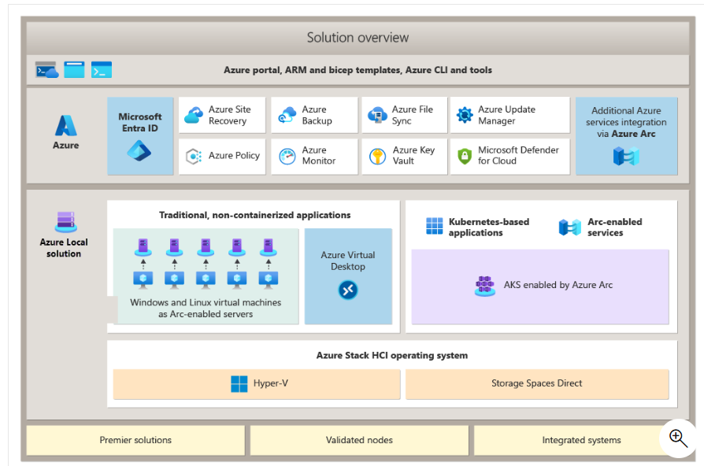
Compute Updates
GA: Azure Local
Azure Stack HCI is now part of Azure Local. An Azure Local instance consists of a machine or a cluster of machines running the Azure Stack HCI operating system and connected to Azure. You can use the Azure portal to monitor and manage individual Azure Local instances as well as view all the deployments of Azure Local. You can also manage Azure Local with your existing tools, including Windows Admin Center and PowerShell.
Azure Local is built on proven technologies including Hyper-V, Storage Spaces Direct, and core Azure Management service.
Each Azure Local instance consists of 1 to 16 physical machines. All machines share common configurations and resources by leveraging the Windows Server Failover Clustering feature.
Validated hardware from a hardware partner.
Azure Stack HCI OS.
Hyper-V-based compute resources.
Storage Spaces Direct-based virtualized storage.
Windows and Linux virtual machines as Arc-enabled servers.
Azure Virtual Desktop.
Azure Kubernetes Service (AKS) enabled by Azure Arc.
AI and machine learning workload deployment.
Azure services including monitoring, backup, site recovery, and more.
Azure portal, Azure Resource Manager and Bicep templates, Azure CLI and tools.

Slide 21
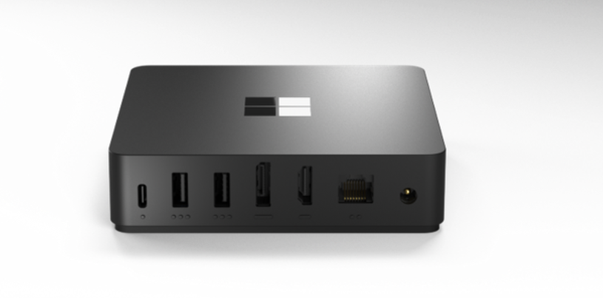
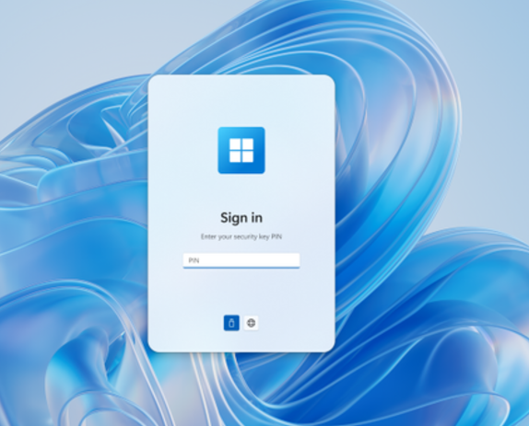
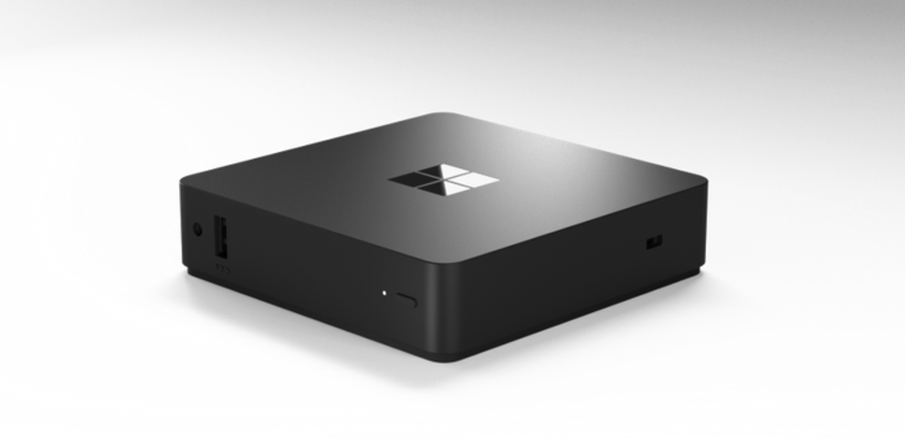
Compute Updates
Windows 365 Link—the first Cloud PC device for Windows 365
MS introduced Windows 365 Link, the first Cloud PC device purpose-built by Microsoft to connect securely to Windows 365 in seconds.
Cloud-powered performance - It takes seconds to boot and instantly wakes from sleep, allowing users to quickly get started or pick up where they left off on their Cloud PC. With dual 4K monitor support, four USB ports, an Ethernet port, Wi-Fi 6E, and Bluetooth 5.3, Windows 365 Link offers seamless connectivity with both wired and wireless peripherals.
Secure by design
Simplified IT management

Slide 22
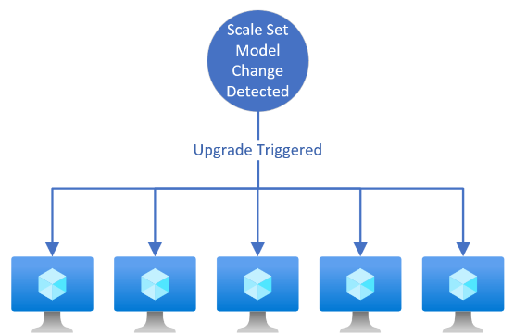
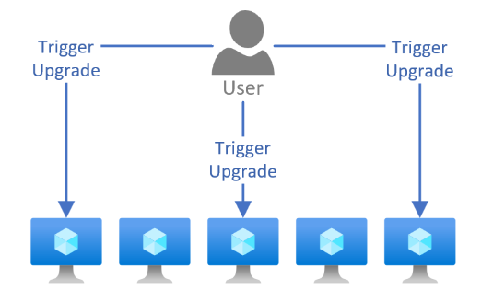
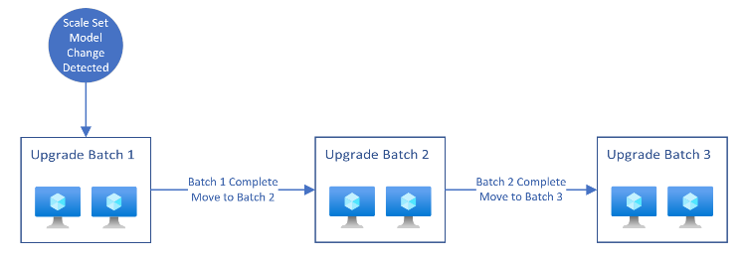
Compute Updates
GA: Upgrade Policies on VMSS with Flexible Orchestration
Upgrade policies allow for more granular control over the upgrade process, ensuring that services remain available and responsive during updates. The available upgrade policies are: Automatic, Manual, and Rolling.
Automatic upgrade policy: the scale set makes no guarantees about the order of virtual machines being brought down. The scale set might take down all virtual machines at the same time to perform upgrades. Automatic upgrade policy is best suited for DevTest scenarios where aren't concerned about the uptime of your instances while making changes to configurations and settings.
Manual upgrade policy: Nothing happens automatically to the existing virtual machines when changes occur to the scale set model. New instances added to the scale set use the most update-to-date model available. Manual upgrade policy is best suited for workloads where require more control over when and how instances are updated.
Rolling upgrade policy: the scale set performs updates in batches. More control over the upgrades with settings like batch size, max healthy percentage, prioritizing unhealthy instances and enabling upgrades across availability zones. Rolling upgrade policy is best suited for production workloads that require a set number of instances always be available. Rolling upgrades is safest way to upgrade instances to the latest model without compromising availability and uptime.

Slide 23
Compute Updates
Generally Available: VMSS Zonal Expansion
MS announced that the Azure VMSS Zonal Expansion feature is now generally available. This significant enhancement allows to transition virtual machine scale sets from a regional to zonal resiliency strategy or add additional zones to a scale set. By distributing VMs across multiple zones, customers can significantly enhance their business continuity and resilience, achieving a higher availability Service Level Agreement (SLA) of 99.99% compared to the previous 99.95%.
The Azure VMSS Zonal Expansion feature simplifies the migration process, enabling customers to update their scale set environment to the Azure recommended zone-redundant availability strategy without the need to delete and recreate instances or experience application downtime.
During Expansion scale set to additional zones, the original instances are not migrated or changed. When scale out, new instances will be created and spread evenly across the selected availability zones. Data from the original instances are not migrated to the new zones.
This feature allows to add zones to the scale set. It is now possible to go back to a regional scale set or remove zones once they have been added.
Public Preview: Resilient create and delete on VMSS
MS announced new feature that increases virtual machine create and delete success in scale sets. Resilient create and delete initiates auto-recovery from failed create and deletes by performing retries of those operations on behalf – ultimately reducing the manual effort required to detect and clean up unused resources. These errors are rare, but our mechanism is built for customers who are deploying or deleting large volumes of Scale Sets or virtual machines.
Key Benefits
Fast detection of failed virtual machine operations due to control plane errors
Fast and reliable initiation of the recovery process after an unhealthy virtual machine is detected
Increased orchestration of recovery by performing multiple retries of create and delete operations
Reliable initiation of cleaning up unusable capacity

Slide 24
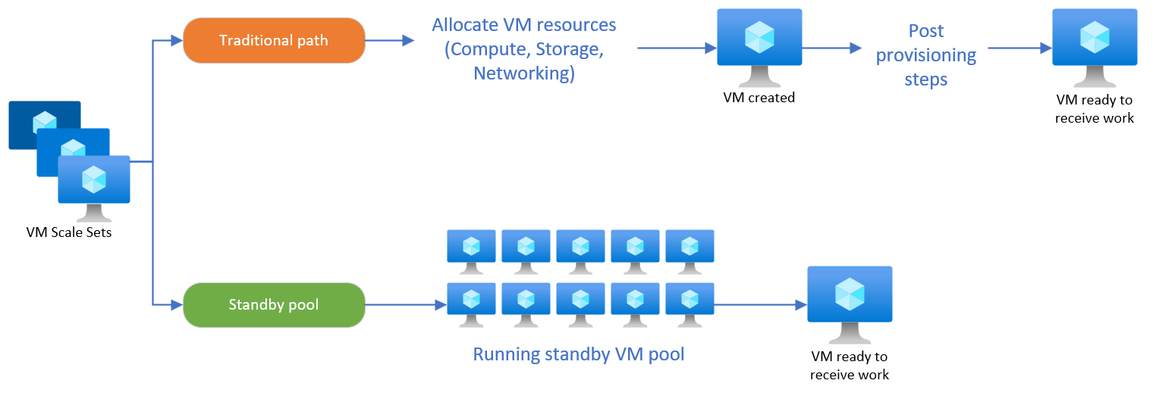
Compute Updates
Public Preview: Customer Metrics for rolling upgrades on VMSS
Custom metrics for rolling upgrades enables to utilize the application health extension to emit custom metrics to Virtual Machine Scale Set. These custom metrics can be used to tell the scale set the order in which virtual machines should be updated when a rolling upgrade is triggered. The custom metrics can also inform scale set when an upgrade should be skipped on a specific instance.
GA: Standby Pools for VMSS with Flexible Orchestration
Standby Pools for Virtual Machine Scale Sets with Flexible Orchestration is now generally available.
Standby pools for Virtual Machine Scale Sets enables to increase scaling performance by creating a pool of pre-provisioned virtual machines. The virtual machines in the standby pool complete all post provisioning processes such as installing applications, downloading data packages, etc. Once the virtual machines have been fully provisioned, they can be maintained in a running or a stopped (deallocated) state. When your scale set requires more instances, the instances in the standby pool are automatically moved into the scale set. A standby pool significantly reduces the time it takes to scale out a Virtual Machine Scale Set.

Slide 25
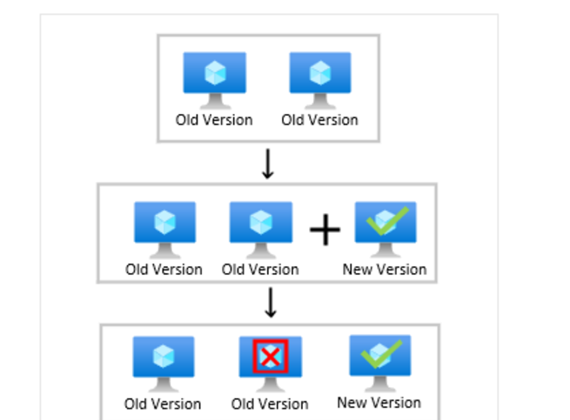
Compute Updates
General Availability: MaxSurge for Virtual Machine Scale Sets
MaxSurge can help improve service uptime during upgrade events. Rolling upgrades with MaxSurge creates new instances with the latest scale set model to replace instances running with the old model. By creating new instances instead of upgrading instances in place, it is possible to ensure that scale set capacity doesn't drop below the set instance count during the duration of the upgrade process.

Slide 26
Compute Updates
General Availability: Azure Function Flex Consumption Plan
Flex Consumption is a Linux-based Azure Functions hosting plan that builds on the Consumption pay for what you use serverless billing model. It gives you more flexibility and customizability by introducing private networking, instance memory size selection, and fast/large scale-out features still based on a serverless model.
The Flex Consumption plan builds on the strengths of the Consumption plan, which include dynamic scaling and execution-based billing.
Flex Consumption provides extra features:
Always-ready instances
Virtual network integration
Fast scaling based on concurrency for both HTTP and non-HTTP apps
Multiple choices for instance memory sizes
GA: .NET 9
Azure PaaS services, including Azure App Service, Azure Functions, Azure Container Apps, and more, now fully support .NET 9.
Customers can now leverage the enhanced capabilities of .NET 9, such as significant performance improvements, adaptive garbage collection, and support for ARM64 optimizations, to build and deploy cloud-native and AI-powered applications more efficiently. They can also take advantage of seamless integration with Azure services to scale and manage their .NET 9 applications with improved observability and reduced cloud costs.
Language stack | Required version
C# (isolated process mode)¹ | .NET 8²
Java | Java 11, Java 17
Node.js | Node 20
PowerShell | PowerShell 7.4
Python | Python 3.10, Python 3.11

Slide 27
Compute Updates
PP: .NET Aspire support for Azure Function projects
.NET Aspire is an opinionated stack that simplifies development of distributed applications in the cloud. It is now possible to enlist Azure Functions projects using .NET on the isolated worker model into Aspire orchestrations using preview support. This equips teams author event-driven functions as part of microservice solutions in Aspire. Those functions can then take advantage of .NET Aspire’s features around service discovery, OpenTelemetry, and more.
The Aspire.Hosting.Azure.Functions NuGet package allows to reference Functions projects from Aspire app host projects. It is also possible to use additional Aspire integrations to configure triggers and bindings for Azure Blobs, Azure Queues, Azure Event Hubs, and Azure Service Bus.
This integration can be used by projects targeting .NET 8 and .NET 9. Please note that when deploying the Aspire solution to Azure, Functions projects are deployed as Azure Container Apps resources without event-driven scaling.
GA: Sidecar extensibility in Azure App Service
MS announced the General Availability (GA) of sidecar support for both source-code and container-based applications on Azure App Service for Linux. This feature is a significant step forward in providing robust, flexible cloud services, further empowering developers to create resilient and scalable applications with ease. It enables developers to leverage various extensibility scenarios such as monitoring, logging, caching, and networking without making complex changes to primary application code.
As AI workloads continue to grow, sidecar support facilitates the incorporation of modern capabilities in existing apps, for instance, adding vector caching providers alongside enterprise applications. Another example is deploying NGINX proxies in front of applications which allows for precise control over inbound traffic routing. With straightforward sidecar configurations, developers can seamlessly integrate third-party application performance monitoring and logging providers. In-memory caching can also be efficiently added by attaching a Redis sidecar to an application.

Slide 28
Compute Updates
Public Preview: Serverless GPUs in Azure Container Apps
Serverless GPUs enable to seamlessly run AI workloads on-demand with automatic scaling, optimized cold start, per-second billing with scale down to zero when not in use, and reduced operational overhead to support easy real-time custom model inferencing and other machine learning tasks.
At public preview launch, serverless GPUs powered by NVIDIA A100 and NVIDIA T4 GPUs, will be supported in limited regions.
Public Preview: Planned maintenance in Azure Container Apps
Azure Container Apps now offers planned maintenance in public preview. This feature allows to control when non-critical updates are applied to Container Apps environment to minimize downtime and impact to applications. Non-critical updates include minor security patches, bug fixes, and new releases. Critical and urgent updates, however, are applied as needed to ensure security and reliability compliance, even outside of planned maintenance windows.
To configure a weekly maintenance window, just specify a day of week, a start time in the UTC time zone, and a duration.
NOTE: Critical updates are not part of the planned maintenance

Slide 29
Compute Updates
GA: Dynamic sessions in Azure Container Apps
The dynamic sessions in Azure Container Apps is a fast, sandboxed, ephemeral compute, suitable for running AI-generated, untrusted code at scale in hostile multi-tenancy scenarios. Each session has full compute isolation using Hyper-V.
There are two modes:
Code interpreter sessions:. Allow to run Python code using preinstalled popular Python packages.
Custom container sessions: Allows to use a custom container to create a code interpreter for specific needs, such as preinstalling dependencies or supporting a different language.
Public Preview: Private Endpoint support in Azure Container Apps for workload profiles environments
It allows to connect to Container Apps environment using a private IP address in Azure Virtual Network, eliminating exposure to the public internet and securing access to applications. With private endpoints, also possible to connect directly from Azure Front Door to workload profile environments over a private link instead of the public internet.
This feature is supported for both Consumption and Dedicated plans in workload profile environments. Private endpoints are supported for both new and existing environments

Slide 30
Compute Updates
Public Preview: Standby Pools for Azure Container Instances
Standby Pools for Azure Container Instances is now in public preview.
Standby Pools for Azure Container Instances enable customers to create a pool of pre-provisioned container groups that can be used to scale out in response to incoming traffic. The container groups in the pool are fully provisioned, initialized, and ready to receive work at any given notice.
Standby Pools for Azure Container Instances utilize a container group profile to determine how instances within the pool should be configured. Additionally, when requesting a container group from the pool, customers can use config maps to apply updated parameters to the container groups without incurring a restart.
GA: Trusted launch enabled AKS nodes
Trusted Launch enabled nodes are now generally available on AKS. Trusted launch improves the security of generation 2 virtual machines (VMs) by protecting against advanced and persistent attack techniques. It enables administrators to deploy AKS nodes, which contain the underlying virtual machines, with verified and signed bootloaders, OS kernels, and drivers. By using secure and measured boot, administrators gain insights and confidence of the entire boot chain's integrity.
Trusted launch is composed of several coordinated infrastructure technologies that can be enabled independently. Each technology provides another layer of defense against sophisticated threats.
vTPM - Trusted launch introduces a virtualized version of a hardware Trusted Platform Module (TPM), compliant with the TPM 2.0 specification. It serves as a dedicated secure vault for keys and measurements.
Secure Boot - At the root of trusted launch is Secure Boot for your VM. This mode, which is implemented in platform firmware, protects against the installation of malware-based rootkits and boot kits.

Slide 31
Compute Updates
Public Preview: Auto instrumentation for AppInsight in AKS
Auto-instrumentation for AppInsights is now available in public preview for Azure Kubernetes Service. Auto-instrumentation enables Application Insights to make telemetry like metrics, requests, and dependencies available in Application Insights resource. It provides easy access to Application performance monitoring (APM) experiences such as the application dashboard and application map.
Auto-instrumentation automatically injects the Azure Monitor OpenTelemetry distro into application pods to generate application monitoring telemetry.
This preview supports .NET, Java, and JavaScript (Node.js).
Public Preview: Dynamic system node pool creation in AKS Automatic
AKS Automatic will now dynamically select an appropriate virtual machine SKU for the system node pool based on the capacity available in Azure subscription.

Slide 32
Compute Updates
Public Preview: AKS Security dashboard
AKS introduced a security dashboard in the portal. It is now possible to have full visibility over the vulnerabilities of runtime and host in AKS cluster. Defender for Cloud blade in the Azure Kubernetes Service (AKS) portal offers a simplified and streamlined experience for the resource owner or a cluster administrator, in preview. This capability is unique to Microsoft as it provides granular visibility into the container posture assessments (vulnerability assessment, compliance, security best practices, CVE remediation) and offers actionable security insights at a cluster level, without the cluster admin having to leave the AKS portal.
GA: Upgrade algorithm improvements in AKS
AKS upgrades currently fail when encountering a Pod drain failure. To improve upgrade efficiency, a new algorithm is being introduced. It allows to configure upgrades so that if a node is blocked, AKS will use any available surge capacity to continue upgrading other nodes, labeling the blocked node as 'quarantined'. Failure error messages are updated to reflect the post-upgrade status accurately.
The default upgrade behavior is Schedule, which consists of a node drain failure causing the upgrade operation to fail, leaving the undrained nodes in a schedulable state. Alternatively, you can select the Cordon behavior, which skips nodes that fail to drain by placing them in a quarantined state, labels them kubernetes.azure.com/upgrade-status:Quarantined, and proceeds with upgrading the remaining nodes. This behavior ensures that all nodes are either upgraded or quarantined. This approach allows you to troubleshoot drain failures and gracefully manage the quarantined nodes.

Slide 33
Compute Updates
GA: Intelligent cross-cluster K8S resource placement using Azure K8S Fleet Manager.
Application developers often need to deploy Kubernetes resources into multiple clusters. Fleet operators often need to pick the best clusters for placing the workloads based on heuristics such as cost of compute in the clusters or available resources such as memory and CPU. It's tedious to create, update, and track these Kubernetes resources across multiple clusters manually.
Fleet now provides an intelligent resource placement capability that can make scheduling decisions based on the following properties: node count, cost of compute in target member clusters, and resource (CPU/Memory) availability in target member clusters.
Public Preview: Multi-Cluster Auto-upgrade in Azure K8S Fleet Manager Kubernetes Fleet is announcing auto-upgrade support, which provides an automated trigger for update runs based on new Kubernetes or node image versions being published to Azure. Admins can create multiple auto-upgrade profiles for their fleet to capture combinations of Kubernetes and node image version updates. Additionally, existing update run strategies can be used to determine the order in which clusters are updated, while guaranteeing cluster upgrades occur within the maintenance windows configured at each cluster.

Slide 34

Compute Updates
GA: Extended workload scheduling capabilities in Azure K8S Fleet Manager
There are two generally available capabilities as part of the extended scheduling: cluster and namespace-wide attribute overrides for resources.
At the cluster level, operators can use ClusterResourceOverride to define rules based on cluster labels, specifying changes to be applied to various cluster-wide resources such as namespaces, cluster roles, cluster role bindings, or custom resource definitions (CRDs). These modifications might include updates to permissions, configurations, or other parameters. For namespace-level control, a ResourceOverride can be used define rules based on cluster labels, specifying changes to be applied to resources such as Deployments, StatefulSets, ConfigMaps, or Secrets. These changes can include updates to container images, environment variables, resource limits, or any other configurable parameters.
Announcing Azure HBv5 Virtual Machines
This new virtual machine (VM) is optimized for the most memory bandwidth-intensive HPC applications, such as computational fluid dynamics, automotive and aerospace simulation, weather modeling, energy research, molecular dynamics, computer aided engineering, and more. Each Azure HBv5 VM will feature:
6.9 TB/s of memory bandwidth (STREAM Triad) across 400-450 GB of RAM (HBM3)
Up to 9 GB of memory per core (customer configurable)
Up to 352 AMD EPYC “Zen4” CPU cores, 4 GHz peak frequencies (customer configurable)
2X total Infinity Fabric bandwidth among CPUs as any AMD EPYC™ server platform to date
SMT disabled, single-tenant only design (1 VM per server)
800 Gb/s of NVIDIA Quantum-2 InfiniBand, balanced as 200 Gb/s per CPU SoC
Azure VMSS Flex to scale MPI workloads to hundreds of thousands of HBM-powered CPU cores
160 Gbps of Azure Accelerated Networking via 2nd generation Azure Boost NIC
14 TB local NVMe SSD delivering up to 50 GB/s read and 30 GB/s write bandwidth

Slide 35
Compute Updates
GA: Kubernetes Metadata and Logs Filtering in Azure Monitor – Container Insights
MS announced the general availability of Kubernetes Metadata and Logs Filtering in Azure Monitor – Container Insights! This enhancement adds Kubernetes metadata to the ContainerLogsV2 schema, including PodLabels, PodAnnotations, PodUid, Image, ImageID, ImageRepo, and ImageTag.
It is possible to customize metadata fields via ConfigMap, and all fields are collected by default. The new Logs Filtering feature allows for precise filtering of both workload and system pods/containers.
Additionally, the enhanced ContainerLogV2 schema includes log level information to assess application health with color-coded severity levels. A Grafana Dashboard is available for visualizing log levels, log volume, rate, records, and more, empowering in-depth analysis and real-time monitoring. These advancements provide users with richer context and improved visibility into their workloads.

Slide 36
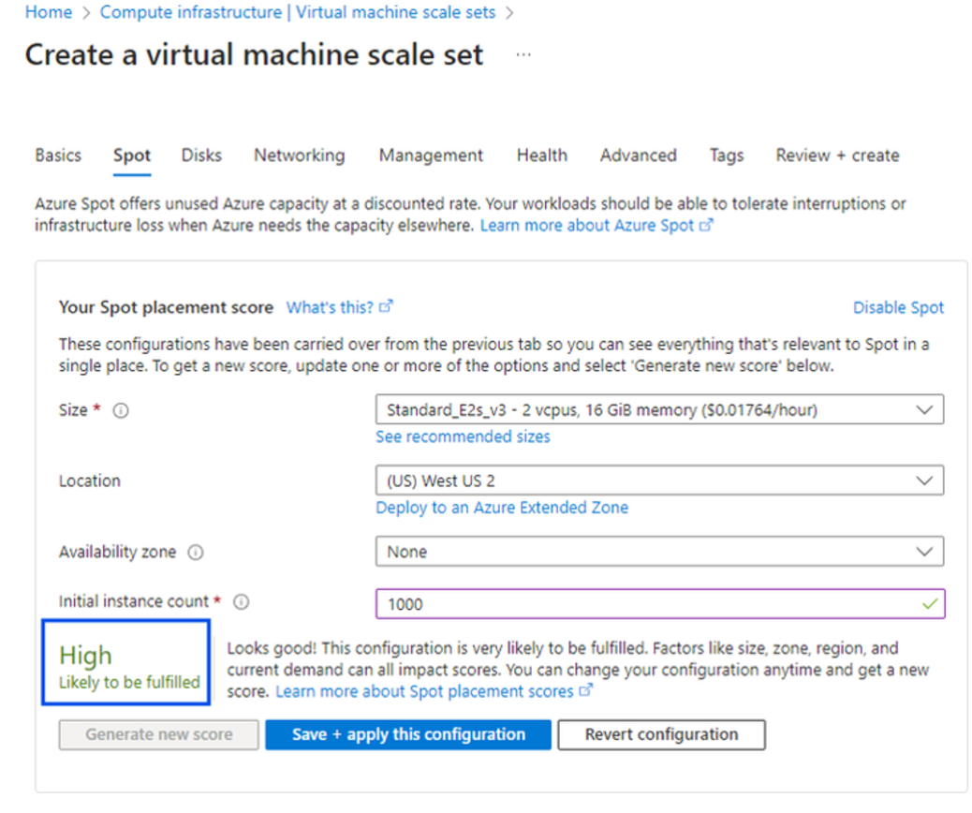
Compute Updates
Public Preview: Spot Placement Score
MS announced the public preview of Azure Spot Placement Score, a feature designed to help assess the likelihood of success for Spot VM deployments. Given that Spot availability can fluctuate based on SKU size, location, availability zones, or time of day, Spot Placement Score provides the ability to evaluate the chance of deployment success by assigning a rating of High, Medium, or Low to a Spot VM size before deployment. This feature provides increased clarity and control, enabling to make more informed decisions about which Spot VMs to deploy and where.
A clear evaluation of how likely Spot deployments is to succeed based on specified parameters.
Identify the most suitable combination of regions and VM sizes to maximize Spot VM availability and survivability based on placement scores.
Improve the overall success rate of deploying Spot VMs by leveraging data-driven placement scores, reducing the risk of capacity issues or failures during deployment.

Slide 37
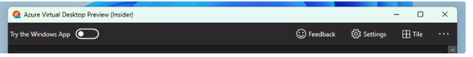
Compute Updates
Migrate from Azure Virtual Desktop Preview app to Windows App
Starting November 27, 2024, the Azure Virtual Desktop Preview app from the Microsoft Store will no longer be available for download or installation. Users of the Azure Virtual Desktop Preview app need to transition to Windows App.
Azure Virtual Desktop customers will continue to receive support for the Azure Virtual Desktop Preview app until it reaches end of support on December 27, 2024. After that date, it will no longer be eligible for support and won’t receive security or feature updates.
Azure Compute Fleet - Empowering Large-Scale Deployments
Azure Compute Fleet, a new offering designed to simplify and optimize large-scale virtual machine (VM) deployments.
Scale Like Never Before - Deploy up to 10,000 virtual machines in a single API call, simplifying large-scale infrastructure management and reducing deployment overhead.
Mix-and-Match VM Sizes - Combine up to 15 different VM sizes and families within a single fleet.
Smarter Deployment Optimization
Azure Compute Fleet now supports advanced allocation strategies, empowering you to:
Optimize for maximum capacity to meet demanding workloads.
Minimize costs by prioritizing the lowest price VMs.
Strike a balance between capacity and cost for an ideal deployment strategy.
Prioritized Fleet Allocation for Standard VMs
Multi-Region Compute Fleet (Preview)
Attribute-Based VM Selection (Preview)

Slide 38
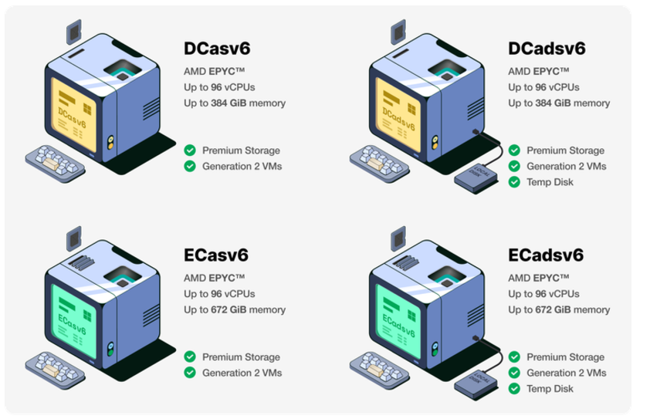
Compute Updates
Preview: New DCasv6 and ECasv6 confidential VMs based on 4th Generation AMD EPYC™ processors
Microsoft Azure announces the preview of confidential virtual machines (CVMs) powered by 4th Generation AMD EPYC™ CPUs. These CVMs represent a milestone for confidential computing on Azure in the areas of security, performance, and global regional availability.
Public Preview: Introducing security baseline with auto-remediation for Linux hybrid workload
The new Azure security baseline for Linux provides enhanced monitoring of compliance status across Linux workloads. It offers more accurate and detailed compliance information and helps customers meet regulatory requirements faster. Combined with the auto-remediation capabilities, it will offer a holistic approach across hybrid environments to deal with continuous compliance and hardening on Linux workloads.
Key highlights of the Azure security baseline for Linux:
Provided at no cost, except for the Azure Arc workloads (on-prem / other CSP).
Enhanced compliance experience with more accurate state (Public Preview).
Detailed information about the state of compliance (Public Preview)
Fully open-sourced engine for compliance and remediation (Public Preview).
Auto-remediation capabilities against the security baseline (Limited Public Preview).

Slide 39
Storage & Data

Slide 40
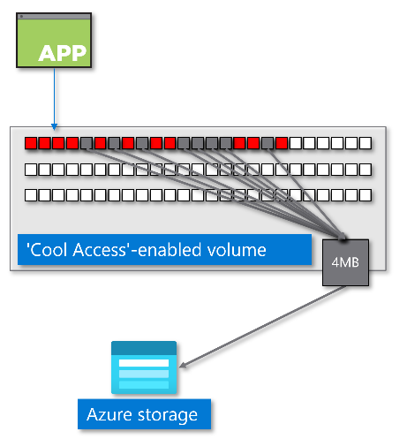
Storage & Data Updates
GA: Azure NetApp Files cool access support for large volumes
MS Announced the general availability of cool access feature support with large volumes. This allows tiering of infrequently accessed data on large volumes under standard, premium or ultra storage, to a lower-cost storage tier.
Azure NetApp Files storage with cool access, allows to configure inactive data to move from Azure NetApp Files storage (the hot tier) to an Azure storage account (the cool tier). Enabling cool access moves inactive data blocks from the volume and the volume's snapshots to the cool tier, which results in cost savings.
GA: Enhancements on Azure Container Storage for performance, scalability, and operational insight
MS excited to unveil key advancements in Azure Container Storage, purpose-built storage solution for stateful containers on Azure Kubernetes Service (AKS). These updates bring increased performance and improved reliability to support even the most demanding containerized applications.
MS optimized ephemeral disk performance to improve read and write IOPS. These enhancements include updates to local NVMe performance both with and without replication, detailed here:
Optimize performance when using local NVMe without replication.
Optimize performance when using local NVMe with replication.
With these new capabilities, Azure Container Storage empowers to achieve optimal performance, visibility, and resilience, making it an even stronger choice for deploying scalable, containerized applications in the cloud

Slide 41
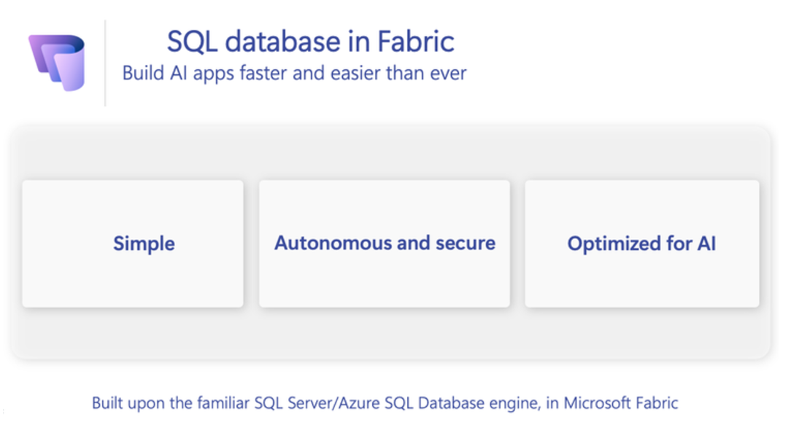
Storage & Data Updates
Announcing SQL database in Microsoft Fabric public preview
The SQL Server and Azure SQL team announced the Public Preview of SQL database in Microsoft Fabric. This new simple, autonomous and secure, and optimized for AI service will help you in the era of AI.
Announcing preview of Workspace Monitoring
Workspace monitoring allows Fabric developers and admins to access detailed logs and performance metrics for their workspaces. This helps troubleshoot performance issues, investigate errors, optimize queries, and minimize data downtime. Workspace monitoring provides visibility into operations crucial for observing system health, resource optimization, and operational planning. Insights derived from this data can improve performance tuning, capacity planning, resource allocation, and decision-making, while also aiding compliance and auditing by maintaining detailed logs.
Key Features of Workspace Monitoring
Monitoring Database: Read-only monitoring Eventhouse to surface logs and metrics from Fabric workloads.
End-to-end visibility: Consistent, standardized troubleshooting experience across supported Fabric items.
Log analysis: Analyze historical logs and detect anomalies with KQL queries and time-series analysis.
Detailed diagnostic logs: Access granular logs and metrics including query text, operation details, CPU consumption, etc

Slide 42
Storage & Data Updates
GA: OneLake catalog – a complete catalog for discovery management, governance.
OneLake catalog is a complete solution to explore, manage, and govern entire Fabric data estate. The OneLake catalog comes with two tabs, Explore and Govern, that can help all Fabric users discover and manage trusted data, as well as provide governance for data owners with valuable insights, recommended actions, and tooling. Since the OneLake catalog is an evolution of the OneLake data hub, it already shows up in Microsoft 365 such as Excel and Teams and many other products in the Microsoft cloud for easy data consumption.
PP: Monitor your Fabric Workspaces
Workspace monitoring is designed for admins and developers to view detailed diagnostic logs and workload metrics about their workspaces to troubleshoot performance issues, capacity performance, and data downtime. Fabric will provide a read-only Eventhouse KQL database of workspace logs that users can query ad-hoc, analyze for patterns and anomalies, or save drafted queries as query sets. It is possible to use this database to conduct root-cause analysis for errors, long running queries, refresh failures, and other issues.

Slide 43
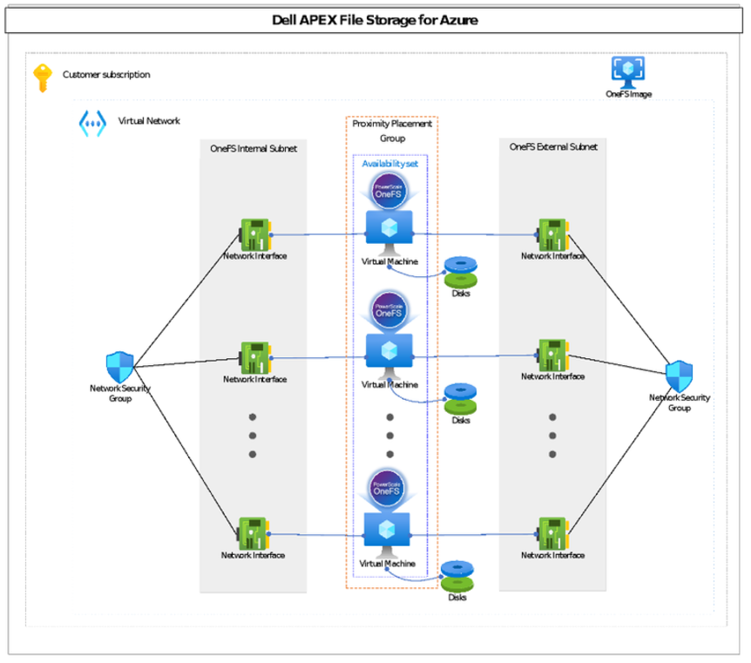
Storage & Data Updates
Dell APEX File Storage for Microsoft Azure
This fully managed service is the result of a co-development effort that brings Dell’s software-defined OneFS storage to Azure as an easy-to-deploy and manage multi-PiB Filesystem-as-a-Service. With the new Dell Managed offering, Dell manages the underlying infrastructure and performs platform upgrades.
APEX File Storage for Microsoft Azure, Customer Managed edition can be purchased through the Azure Marketplace and deployed via Terraform. Can be can scaled to 18 nodes and 5.6PiB of capacity.
Announcing the Next generation Azure Data Box Devices
MS Announced the preview of Azure Data Box 120 and Azure Data Box 525, next-generation compact, NVMe-based Data Box devices. New features:
NVMe devices
High-speed transfers to Azure with data upload up to 5x faster for medium to large files, reducing the lead time for your data to become accessible in the Azure cloud.
Improved networking with support for up to 100 GbE connections
Secure boot functionality with hardware root of trust and Trusted Platform Module (TPM) 2.0.
AES 256-bit BitLocker software encryption
Two options with usable capacity of 120 TB and 525 TB in a compact form factor meeting OSHA requirements
Devices ship the next day air in most regions.

Slide 44
Databases

Slide 45
Databases Updates
Public Preview: Azure SQL Managed Instance mirroring to Microsoft Fabric
It is now possible to use mirroring to easily replicate Azure SQL Managed Instance data to Microsoft Fabric. Mirroring replicates data in near real-time directly into Fabric OneLake. Using mirroring helps avoid complex Extract Transform Load (ETL) processes and reduce total cost of ownership while gaining faster time to insights. Fabric unlocks powerful business intelligence, artificial intelligence, data engineering, data science, and data sharing scenarios.
GA: Mirroring Azure SQL Database in Fabric
MS announced the general availability of Mirroring Azure SQL Database in Fabric. Mirroring is a simple, free, and frictionless way to replicate a snapshot of incremental data changes in Azure SQL Database to Fabric OneLake. Delta tables keep data in sync in near-real time. Mirroring is a low-cost, zero-code, zero-ETL solution that brings data together, driving faster time to insight.
Key GA Features
Seamless Data Definition Language (DDL) support
Programmatic Mirroring APIs
Support source Schema hierarchy
Firewall Connectivity

Slide 46
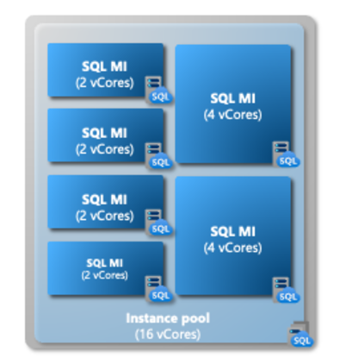
Databases Updates
Public Preview: MySQL 9.1 Innovation release support
MS announced that Azure Database for MySQL now supports the MySQL 9.1 Innovation release, bringing the latest features to database experience. This release includes exciting new capabilities, such as JavaScript for stored procedures and vector datatype support, expanding your options for application development and advanced data processing.
It gives access to the latest features and enhancements as they’re introduced, keeping applications at the forefront of technology. Take advantage of these innovative tools by exploring Azure Database for MySQL today and discovering how you can elevate your database solutions with MySQL 9.1.
GA: Azure SLQ Managed Pool
Now generally available, instance pools give a flexible way to deploy compute resources for Azure SQL Managed Instance. It is possible to deploy cost-effective, two-vCore instances, providing an ideal platform as a service (PaaS) target for small instances when migrating SQL Server to Azure or when running existing Azure SQL Managed Instance fleet.
It is possible to resize an instance pool or use it to contain instances of different sizes.
Many organizations apply centralized provisioning of cloud resources due to security, architecture, and budget control purposes. Instance pools provide a flexible way to organize and provision Azure SQL Managed Instance with a two-vCore granularity.

Slide 47
Databases Updates
PP: MySQL 8.4 LTS for Azure Database MySQL
MS announced the release of MySQL 8.4 LTS for Azure Database for MySQL, a stable, long-term support version. MySQL 8.4 LTS is the ideal choice when it is needed a dependable, consistent database solution that evolves with needs.
It is possible to confidently build and scale applications using Azure Database for MySQL, knowing there is the latest in performance optimizations, security enhancements, and Azure integration features—fully supported over the long term. This release gives the benefit of ongoing updates, minimizing disruptions and helping you maintain a resilient infrastructure for your mission-critical workloads.

Slide 48
Databases Updates
Public Preview: DiskANN vector indexing and search in vCore-based Azure Cosmos DB for MongoDB
MS announced the public preview of DiskANN with filtering in vCore-based Azure Cosmos DB for MongoDB. With DiskANN, it is possible to perform large-scale vector searches while reducing memory usage by up to 10 times compared to other algorithms like IVFFlat and HNSW—making recommendation engines, fraud detection, and other AI applications more cost-effective and scalable. Enjoy low-latency, high-availability performance, even with billions of vectors.
Public Preview: Full text and hybrid search in Azure Cosmos DB
Azure Cosmos DB for NoSQL powers more generative AI scenarios and to build applications with advanced search capabilities. Three new search features in Azure Cosmos DB for NoSQL, now available in public preview:
Full-text search: Perform efficient text searches on data with advanced text analysis capabilities, including tokenization and stemming. Currently supports English, with more languages coming soon.
BM25 text ranking: Enhance text search relevance with BM25 ranking, which considers term frequency, document length, and term importance to find the most relevant documents in a text search
Hybrid search: Combine vector searches with BM25-based text ranking for highly accurate and contextually relevant results. This feature uses Reciprocal Rank Fusion (RRF) to merge and rank the results for improved relevancy.

Slide 49
Databases Updates
GA: vCore-based Azure Cosmos DB for Mongo DB multishard clusters
Now it is possible to use up to five physical shards on vCore-based Azure Cosmos DB for MongoDB clusters. An increased number of shards in a cluster enables to host larger workloads and get elevated performance through higher concurrency.
When create a vCore-based Azure Cosmos DB for MongoDB cluster, it is possible to select from one to five shards. As before, each physical shard gets the same compute (vCore count and amount of RAM) and storage (GiB and IOPS) configuration.
Using a greater number of physical shards can also help increase cluster performance for larger workloads that require multishard clusters because of better parallelization.
GA: vCore-based Azure Cosmos DB for MongoDB – up to 32 TiB storage
Higher capacity storage with higher IOPS enables to host larger workloads on vCore-based Azure Cosmos DB for MongoDB cluster. Now it is possible to elevate performance by choosing from 8 TiB, 16 TiB, and 32 TiB with 16,000 IOPS, 18,000 IOPS, and 20,000 IOPS respectively. Also it is possible to scale up existing clusters using any of the new storage sizes as your workloads grow.

Slide 50
Databases Updates
GA: Cross-region replication in vCore-based Azure Cosmos DB for MongoDB
It is now possible to create a replica of a cluster in another region. This cluster replica is continuously updated with the data written in the primary region. In the rare case of an outage in the primary region, it is allowed to promote this replica to become the new read-write cluster.
It is allowed to use the cluster replica in another region for reading. This helps offload read operations from the primary cluster and deliver reads with lower latency to applications that are hosted closer to the other region.
When the cluster replica in region B is promoted and becomes the new read-write cluster, it mirrors the original configuration by maintaining a read replica in the former primary region A. The global read-write connection string always points to the cluster available for writes. It allows uninterrupted work with the database after replica cluster promotion.
Public Preview: Data API in vCore-based Azure Cosmos DB for MongoDB
MS announced the public preview of the Data API for vCore-based Azure Cosmos DB for MongoDB. The Data API provides a flexible and powerful way to interact with database through HTTP-based API calls.

Slide 51
Databases Updates
GA: Vector search in Azure Cosmos DB for NoSQL
Now generally available in Azure Cosmos DB for NoSQL, vector search enables applications to perform high-dimensional vector similarity searches. It is possible to take advantage of advanced AI scenarios including semantic search, Retrieval Augmented Generation (RAG), semantic caching, and anomaly detection. This release also improves performance, including faster vector ingestion and lower search latencies, and offers compatibility with popular Azure Cosmos DB for NoSQL capabilities, such as customer-managed keys, continuous backup, point-in-time restore, and Fabric mirroring. Operational and vector data stays together and in sync, simplifying your data management, AI application architectures, and vector-based operations.
GA: DiskANN in Azure Cosmos DB for NoSQL
MS announced the general availability of Microsoft DiskANN vector index in Azure Cosmos DB for NoSQL. With this cutting-edge vector index type, it is possible to perform fast, accurate vector similarity searches at any scale. This release, get faster DiskANN index builds, improved vector ingestion rates, lower search latencies, and higher accuracy.
Additionally, it is possible to use new index and search parameters to fine-tune performance and accuracy, finding the balance that meets application’s unique needs.

Slide 52
Databases Updates
Public Preview: Introduction Apache graph support in Azure Database for PostgreSQL
It provides a significant advancement in graph processing capabilities within the PostgreSQL ecosystem. It allows to take a full advantage of a powerful set of graph database tools using the robust enterprise features of Azure Database for PostgreSQL. Apache AGE enables to move beyond baseline Retrieval Augmented Generation (RAG) application patterns to GraphRAG powered by Azure Database for PostgreSQL.
Apache AGE provides graph database functionality, enabling to store and query graph data efficiently within PostgreSQL. Using the intuitive openCypher query language, you can easily write expressive graph queries. In addition, can manage and analyze complex relationships within your data, uncovering insights that traditional relational databases and even semantic search might miss.
On-Demand Backups in Azure Database for PostgreSQL Flexible Server - Public Preview
Now it is possible to create on-demand backups whenever required. On-demand backups can be taken in addition to scheduled automatic backups. This feature is especially useful for scenarios such as preparing for potentially high-risk operations like system upgrades or schema changes or performing periodic refreshes that fall outside scheduled backup cadence.
Key Benefits
Flexible Retention: On-demand backups are retained according to specified backup retention window, with the added flexibility to delete them when they are no longer needed.
User Control
Seamless Integration: These backups are stored alongside automated backups, but only on-demand backups are user-deletable. Automated backups remain managed by the Flexible Server service to ensure compliance with retention requirements.
Cost Optimization: While automated backups are managed by Azure and cannot be deleted, on-demand backups provide a control over storage costs. Delete these backups once their purpose is served to avoid unnecessary storage expenses.

Slide 53
Databases Updates
GA: Semantic Ranker Solution Accelerator on Azure Database for PostgreSQL
Accuracy of the information retrieval pipeline plays a key role in the quality of advanced Retrieval Augmented Generation (RAG) applications. Using the new Semantic Ranker Solution Accelerator, it is possible to extend Azure Database for PostgreSQL with a semantic ranker model and use it directly in PostgreSQL queries to boost accuracy of the vector search results.
This solution accelerator provides automated deployment scripts that can use to provision a semantic ranker model as an Azure Machine Learning inference endpoint. It also includes SQL user-defined functions for PostgreSQL that you can use to integrate the semantic ranker model into SQL queries.
This solution accelerator requires azure_ai extension.
GA: Index Tunning in Azure Database for PostgreSQL – Flexible Server
It is now possible to use index tuning to analyze the most resource intensive set of queries in workload and produce recommendations of indexes that, once created, improve the performance of those queries. Index tuning also recommends indexes to drop if they are identified as duplicates or are considered irrelevant for lack of use.
The new index tuning feature builds on query store in Azure Database for PostgreSQL - Flexible Server, which captures and retains a history of queries executed in workload and the runtime statistics of those queries.

Slide 54
Databases Updates
GA: Default Zone Resilience in Azure Database for MySQL – Flexible Server Business Critical Service
With this new enhancement in Dec 2024, mission-critical MySQL workloads on Azure Database for MySQL – Flexible Server Business Critical service tier are now zone-resilient by default—at no additional cost. Even if you don’t configure high availability (HA), Flexible Server will host your data and log files in zone-redundant storage by default. Existing servers configured for zone-redundant HA continue to benefit from the 99.99% uptime service level agreement (SLA) provided by built-in zonal redundancy and hot standby. In addition, servers configured for same-zone HA and non-HA also benefit—they can recover quickly from zonal outages using the zone-redundant backups.
Public Preview: DiskANN indexing on Azure Database for PostgreSQL
MS announced the preview of DiskANN, one of the fastest vector indexing algorithms on the market, which is now available for Azure Database for PostgreSQL. Developed at Microsoft Research, DiskANN is used extensively at Microsoft in global services such as Bing and Microsoft 365.
DiskANN enables to build highly accurate, performant, and scalable generative AI applications that surpass pgvector’s HNSW and IVFFlat indexes in both speed and accuracy. DiskANN also overcomes a long-standing limitation of pgvector in filtered vector search, where it occasionally returns incorrect results.

Slide 55
Databases Updates
Public Preview: Azure Managed Redis
Azure Managed Redis brings the latest Redis innovations with enhanced availability while being more cost-effective. Azure Managed Redis boosts AI application performance, supports session management, and interoperates seamlessly with various Azure services.
With four new tiers, you can now customize your Redis solution to match specific performance and memory requirements. Azure Managed Redis also delivers up to 99.999% availability* for uninterrupted access to mission-critical apps, while offering enterprise-level security and password-free authentication through Microsoft Entra ID.

Slide 56
Integration

Slide 57
Integration Updates
General Available: Premium Integration Account in Azure Logic App
MS announced the General Availability of the Premium Integration Account in Azure Logic Apps, bringing enhanced capabilities for enterprise-grade B2B integrations. Designed to support mission-critical workloads, the Premium Integration Account offers increased limits, higher throughput, and expanded scalability to meet the demands of complex integration scenarios.
With the Premium Integration Account, it is possible to handle complex EDI, AS2, and XML processes with ease, backed by robust security features like Virtual Network (VNET) integration to safeguard your data. This offering is optimized for peak performance, allowing organizations to streamline their business processes while ensuring compliance.
Benefits of the Premium Integration Account
Elevated Limits and Throughput: Process higher volumes of transactions and data, ideal for mission-critical operations.
Expanded Scalability: Scale to meet the needs of growing business requirements without compromising performance.
Advanced Security Features: Utilize VNET support for secure data transmission, ensuring compliance with strict security standards.
The Premium Integration Account in Azure Logic Apps is here to support your most demanding integration workloads with reliability and security.
General Availability of Templates for Azure Logic Apps Standard
MS announced that Templates support for Azure Logic Apps Standard, previously in Public Preview, is now officially Generally Available (GA)! Over the course of the preview, we’ve expanded the library of templates, adding significant value to streamline your workflow development process.
Additionally, MS Introduced Accelerators—multi-workflow templates designed to provide comprehensive solutions for complex business processes. We’re excited to grow this collection further with the support and feedback of our community and customers.

Slide 58
Integration Updates
GA: Automated Build and Deployment for Standard Logic App Workflows with Azure DevOps
MS announced the general availability of automated build and deployment support for Standard logic app workflows in Azure Logic Apps. With this release, it is possible to streamline the deployment process for single-tenant logic apps using Azure DevOps, ensuring consistency and efficiency across environments.
Key Highlights:
Seamless Integration with Azure DevOps: The Azure Logic Apps (Standard) extension provides the tools that is needed to automate the build and deployment of workflows, enabling smooth transitions from development to production.
Local Development and Source Control: Develop, test, and store Logic App projects locally in Visual Studio Code using the Azure Logic Apps (Standard) extension, with support for any source control system.
Consistency Across Environments: Automating build and deployment process ensures that your workflows are deployed uniformly across different platforms, reducing manual effort and minimizing errors.
Start optimizing your workflow deployments today and unlock the power of automated CI/CD for your Logic Apps!
PP: AI Capabilities in the Azure Logic Apps Consumption SKU
MS introduced AI capabilities in the Azure Logic Apps Consumption SKU, now available in public preview! This release brings advanced AI-driven features that empower users to leverage intelligent document processing, search, and language capabilities within Logic Apps, with full feature parity across both the Standard and Consumption SKUs.
Key Features in this Release:
Azure AI Search Connector: A new managed connector that allows to store vector embeddings and perform Vector Search on indexed documents, enabling fast and precise search experiences across large volumes of data.
Azure OpenAI Connector: Enhanced with the ability to generate multiple embeddings at once, this connector now supports efficient bulk creation of vector embeddings, ideal for applications that need to process large datasets for AI-driven insights.
Forms Recognizer (Document Intelligence) Connector: Now includes an action to convert documents into markdown, simplifying the handling of complex documents that include tables, images, and more for easy processing and integration.
This public preview of AI capabilities in the Consumption SKU allows customers to innovate with Logic Apps seamlessly, enjoying the same robust AI features available in the Standard SKU, regardless of their chosen deployment model.

Slide 59
Integration Updates
GA: Deployment slots in Azure Logic Apps Standard
MS announced the General Availability of deployment slots in Azure Logic Apps Standard, a feature designed to enable zero-downtime deployment for mission-critical logic apps. With deployment slots, it is possible now update and deploy new versions of Logic Apps seamlessly, without causing any disruption to end users.
Key Benefits:
Zero Downtime: Ensure applications remain available and responsive during updates or maintenance, providing a seamless experience for users.
Continuous Delivery: Deployment slots allow to deliver updates continuously, enhancing the quality and reliability of applications while avoiding downtime.
Flexible Slot Management: Create and configure multiple deployment slots, enabling staged rollouts, safe testing, and smooth transitions between app versions.
This capability brings enterprise-grade availability to your Logic Apps, allowing you to meet high availability requirements effortlessly.
Public Preview: Logic Apps Hybrid Deployments Model
MS introduced the Logic Apps Hybrid Deployment Model, a new feature in Azure Logic Apps designed to provide more deployment flexibility for customers with unique integration needs. With this model, it is possible to build and deploy workflows that run on customer-managed infrastructure—whether on-premises, in a private cloud, or even in a third-party public cloud.
This hybrid deployment approach allows to customize integration solutions to meet regulatory, privacy, or network-specific requirements by choosing the best environment for your workflows. Running workflows on local compute gives access to local data sources, supports high-throughput processing, and keeps data within your preferred infrastructure. When it is needed connectivity to external resources, like SaaS services, leverage the extensive Azure Logic Apps connector library to integrate those systems.

Slide 60
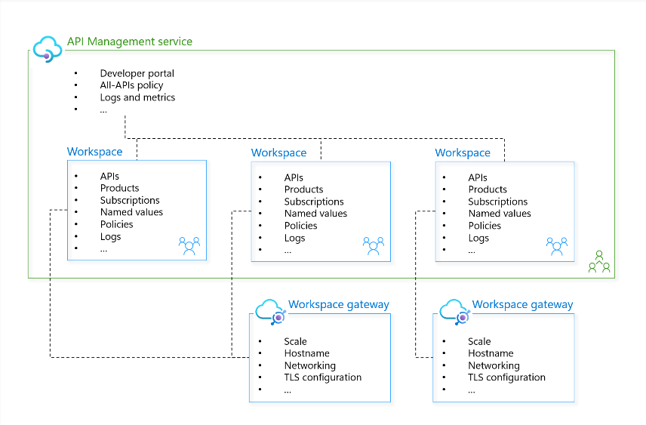
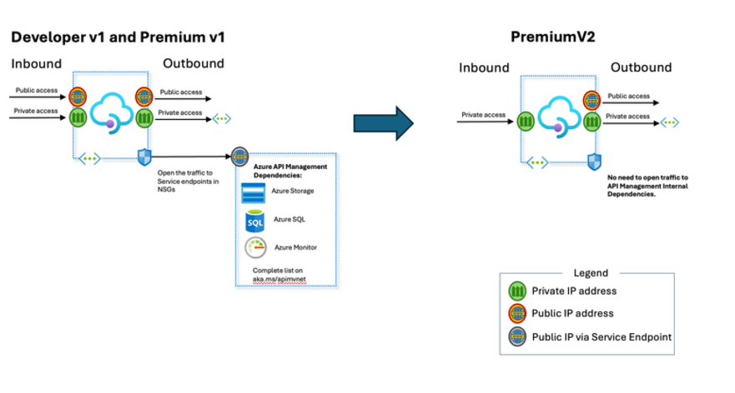
Integration Updates
Public Preview of the Premium v2 tier of Azure API Management
MS announced the public preview of Azure API Management Premium v2 tier. Superior capacity, highest entity limits, unlimited included calls, and the most comprehensive set of features set the Premium apart from other API Management tiers.
The Premium v2 tier has a new architecture that eliminates management traffic from the customer VNet, making private networking much more secure and easier to setup. During the creation of a Premium v2 instance, it is possible to choose between VNet injection or VNet integration (introduced in the Standard v2 tier) options.
GA: Shared Workspace Gateways in Azure API Management
MS announced the general availability of shared workspace gateways in Azure API Management! This new feature introduces the ability to associate multiple workspaces with a single workspace gateway, offering a cost-effective way to federate API management.
With workspaces, organizations can empower API teams to independently manage their APIs, while centralizing oversight and unifying API discovery through the developer portal. By connecting up to thirty workspaces to one gateway, you can now achieve these benefits at a significantly lower cost.

Slide 61
Integration Updates
GA: Synchronization between Azure API Center and Azure API Management
MS announced the synchronization between Azure API Management and Azure API Center! This integration combines the robust governance of API Center with the powerful management capabilities of API Management, delivering a unified solution for API lifecycle management.
With this new feature, it is now possible to easily select an API Management instance to sync directly to API Center. This synchronization enables streamlined API discovery, centralized tracking, and enhanced governance across your organization’s APIs.
Key Benefits:
Unified API Visibility: Seamlessly sync APIs from API Management to API Center for a centralized view across services.
Enhanced Governance: Leverage API Center’s governance features while managing APIs in API Management, ensuring adherence to organizational standards.
Simplified API management: Reduce duplication of effort by maintaining a synchronized ecosystem between API Center and API Management.
This integration offers a cohesive approach to managing and governing APIs across Azure, simplifying the API lifecycle and boosting efficiency.
GA: Fully Managed API Analysis in Azure API Center
With this release, it is possible to enable API analysis effortlessly, with zero manual configuration or upkeep. API linting capabilities automatically examine API definitions, verifying they align with organization’s style and quality standards.
The fully managed API analysis generates detailed reports, both at the individual API level and as comprehensive summaries, offering valuable insights that ensure consistency and high standards across all your APIs.
Key Benefits:
Effortless Management: Enable API analysis without any setup or ongoing management, freeing up your team’s time.
Automated Quality Assurance: API linting checks each definition against your organizational guidelines, helping to standardize and optimize API quality.
Clear Insights and Reports: Access individual and summary reports for a holistic view of API adherence and quality across projects.

Slide 62
Integration Updates
Introducing Local emulator for Azure Service Bus
Azure Service Bus is a fully managed enterprise message broker offering queues and publish-subscribe topics. It decouples applications and services, providing benefits like load-balancing across workers, safe data and control routing, and reliable transactional coordination.
MS announced the introduction of a local emulator for Azure Service Bus. This emulator is intended to facilitate local development experience for Service Bus, allowing developers to develop and test their code against Azure Service Bus, in isolation away from cloud interference. A few of those reasons to consider:
Optimized development loop: The emulator speeds up dev/testing against Azure Service Bus.
Pre-migration trial: Try Azure Service Bus using your existing AMQP applications before migrating to the cloud.
Isolated environment: Use the emulator for dev/test setup without network latency or cloud resource constraints.
Cost-efficient: The emulator is free and can be run on your local machine for dev/test scenarios.
The emulator is accessible as a Docker image on Microsoft Artifact Registry, and it is platform-independent, capable of running on Windows, macOS, and Linux. The emulator is compatible with the latest service bus client SDKs and supports a wide variety of features within Azure Service Bus.

Slide 63
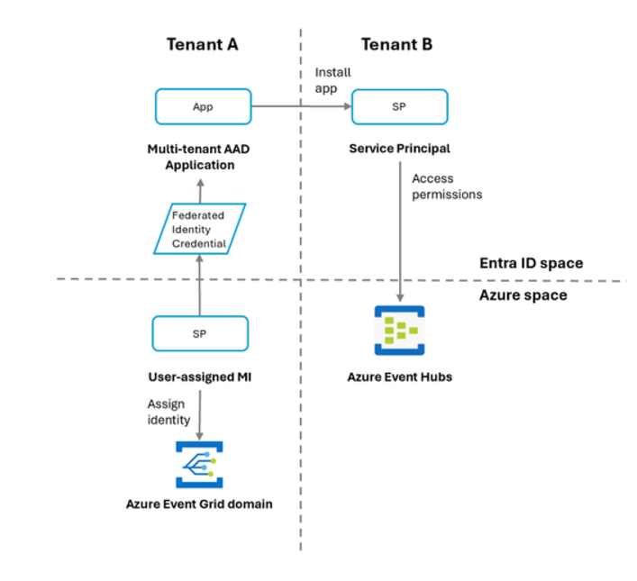
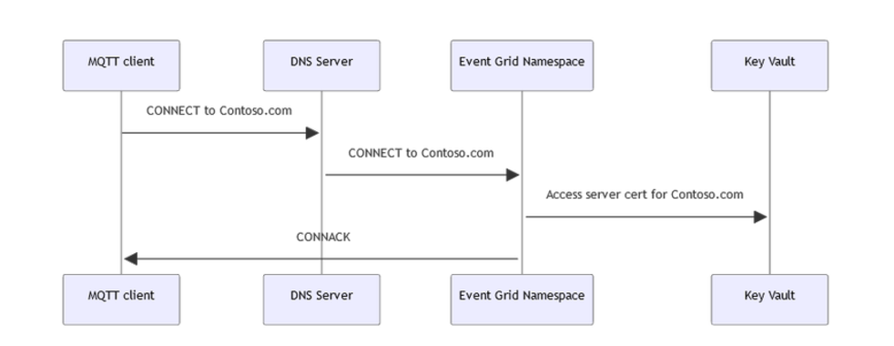
Integration Updates
Announcing new features and updates in Azure Event Grid
General Availability of the webhook endpoints in Azure Event Grid namespace topics. This feature allows for efficient and reliable push delivery to webhooks, expanding the possibilities for event-driven architectures and integrations.
Custom domain names support is now Generally Available in Azure Event Grid’s MQTT broker. This new feature allows to assign own domain names to the MQTT and HTTP endpoints within Azure Event Grid namespaces. By doing so, it is possible to enhance security and simplify client configuration. Additionally, assigning custom domain names to namespaces can help improve availability, manage capacity, and facilitate cross-region client mobility.
MS announced the General Availability of Microsoft Graph API events that provide notifications about state changes of resources in Microsoft Outlook, Teams, SharePoint, Microsoft Entra ID, Microsoft Conversations, and security alerts.
In Public Preview, MS introduced support for cross-tenant delivery to Event Hubs, Service Bus, and Storage Queues using managed identity with federated identity credentials (FIC) in Azure Event Grid topics, domains, system topics and partner topics. This enhancement enables secure and efficient cross-tenant communication for basic resources.

Slide 64
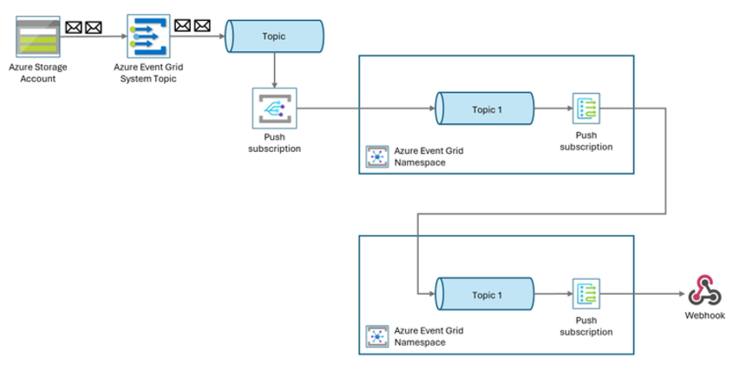
Integration Updates
Public Preview for namespace topic to namespace topic forwarding, enabling seamless event forwarding between topics hosted in the same or different namespaces, simplifying the event routing and management.

Slide 65
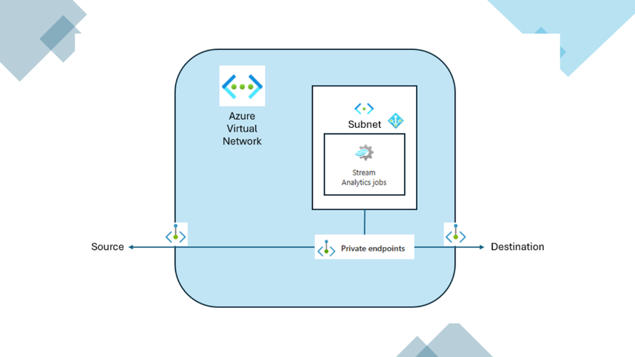
Integration Updates
Azure Stream Analytics Virtual Network Integration Goes GA!
With VNET integration, it is now possible to lock down access to ASA jobs within virtual network infrastructure. This provides enhanced security through network isolation, ensuring that data remains protected and accessible only within private network. By deploying a containerized instance of ASA job inside VNET, it is possibly to privately access resources using:
Private Endpoints: These allow to connect to VNET-injected ASA job to data sources privately via Azure Private Link. This means that data traffic remains within the Azure backbone network, reducing exposure to the public internet and enhancing security.
Service Endpoints: These enable to connect data sources directly to VNET-injected ASA job. This simplifies the network architecture by providing direct connectivity.
Service Tags: These allow to manage network security by defining rules that allow or deny traffic to Azure Stream Analytics. This helps in maintaining a secure environment by controlling which services can communicate with your ASA jobs.
Overall, VNET integration enhances the security of ASA jobs by leveraging Azure's robust networking features.

Slide 66
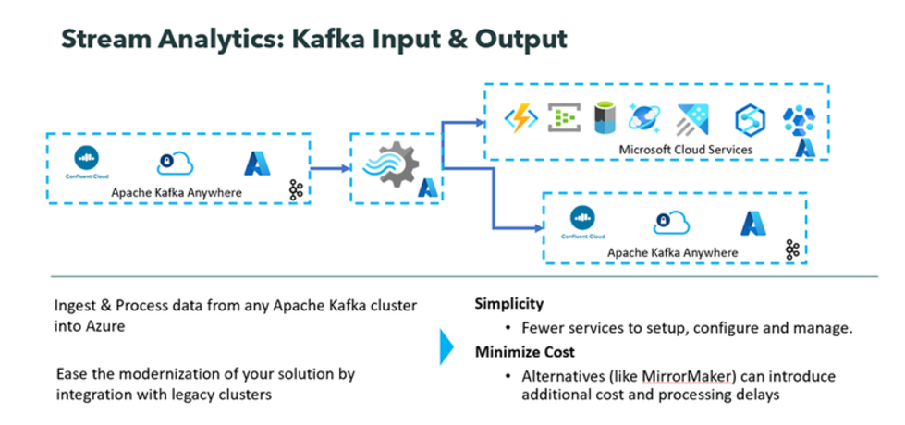
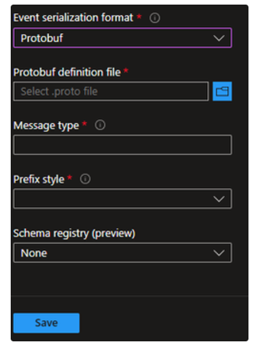
Integration Updates
Generally Available:Protocol Buffers (Protobuf) with Azure Stream Analytics
With the built-in deserializer, Azure Stream Analytics supports an out-of-the-box feature to align with the other file formats , including JSON and AVRO. Using Protobuf, it is possible to handle data streams in a compact binary format, making it ideal for high-throughput, low-latency applications.
Protocol Buffers (Protobuf) is a language-neutral, platform-neutral mechanism for serializing structured data, developed by Google. It is widely used or for saving data in a compact and efficient format. for communication between services
Azure Stream Analytics Kafka Connectors is Now Generally Available!
With Stream Analytics Kafka Connectors, users can natively read and write data to and from Kafka topics. This enables users to fully leverage Stream Analytics' rich capabilities and features even when the data resides outside of Azure. Azure Stream Analytics is a job service, so you do not have to spend time managing clusters, and downtime concerns are alleviated with a 99.99% SLA (Service Level Agreement) at the job level.

Slide 67
Integration Updates
GA: Generative AI Gateway Token Quota Policy in Azure API Management
MS introduced the GenAI Gateway Token Quota Policy in Azure API Management, designed to help organizations manage token consumption effectively when experimenting with large language models (LLMs). This new policy allows administrators to set flexible token quotas on a daily, weekly, or monthly basis, giving you control over cumulative usage and helping prevent unexpected costs.
Key Benefits:
Flexible Quotas: Define token limits on a daily, weekly, or monthly basis to manage consumption across departments or projects.
Cost Management: Protect your organization from unexpected token usage costs by setting quotas that align with your budget and resource allocation.
Enhanced Visibility: Track and analyze token usage patterns to make informed adjustments based on real usage trends.
Azure Load Testing Updates
Support for Multiple JMeter Files - This feature allows to modularize JMeter scripts by uploading multiple JMeter files. This modular approach helps in several ways:
Easier management: By breaking down test plans into smaller, manageable components, it is possible to handle complex test scenarios more efficiently.
Reusability: It is possible to reuse test components across different test plans, which saves time and effort in creating and maintaining tests.
Flexibility: This modularization enables update or modify specific parts of test plan without affecting the entire script, making it easier to adapt to changes.
Scheduling and Notifications
Schedule Load Tests: Plan load tests to run at a later time or set them to run at recurring intervals. This is particularly useful for regular performance checks and regression testing.
Notifications: Receive notifications for important events related to load tests, such as test completion and failures. This ensures stay informed about the status and results of your tests.

Slide 68
ML & AI & IOT

Slide 69
ML & AI & IOT Updates
GA: Support for GPT4o (Text and Images) Across All GenAI Policies in Azure API Management
It is now possible to apply enhanced management and optimization features, including Token Limit Policy, Token Metric Policy, and Semantic Caching Policy, to GPT4o models deployed with Azure OpenAI.
Azure OpenAI Token Limit Policy - With this policy, it is possible to set token-per-minute (TPM) limits for each API consumer, with options to assign limits based on keys like Subscription Key or IP Address.
Azure OpenAI Emit Token Metric Policy - This policy enables automatic token usage reporting to Azure Application Insights, capturing prompt, completion, and total token metrics. It also allows customizable dimensions, such as Subscription ID and IP Address, to help you analyze usage trends and optimize resource allocation.
Azure OpenAI Semantic Caching Policy - This policy utilizes semantic caching to store completions for prompts with similar meanings, using Azure Redis Enterprise or compatible RediSearch caches. The policy leverages the Azure OpenAI Embeddings model to identify and reuse semantically similar completions, saving tokens and enhancing response times.
Public Preview: New Capabilities in Azure Functions OpenAI triggers and bindings preview
Azure Functions now supports creating an OpenAI resource and an optional Azure AI Search vector store for building intelligent applications in Flex consumption portal experience.
Chat assistants
Input binding to chat with LLMs.
Output binding to retrieve chat history from persisted storage.
Skills trigger to extend capabilities of OpenAI LLM through natural language.
Retrieval Augmented Generation (Bring your own data for semantic search)
Data ingestion with Functions bindings.
Automatic chunking and embeddings creation.
Store embeddings in vector database including AI Search, Cosmos DB for MongoDB, and Azure Data Explorer.
Binding that takes prompts, retrieves documents, sends to OpenAI LLM, and returns to user.
Text completion for content summarization and creation
Input binding that takes prompt or content and returns response from LLM.

Slide 70
ML & AI & IOT Updates
GA: Evaluations for quality metrics in Azure AI Foundry
Evaluations for quality metrics are now generally available in Azure AI Foundry, accessible through the code-first Azure AI Foundry SDK experience and no-code Azure AI Foundry portal. These evaluators provide a scalable way to assess text-based models and applications against key performance and quality metrics. This update also includes improvements to pre-existing AI-assisted metrics as well as explanations for evaluation results to help ensure they are interpretable and actionable.
GA: Announcing Azure AI Foundry management center
Management center, now available in Azure AI Foundry portal, provides cross-functional teams with simplified, centralized management and governance controls for GenAI applications. Now, AI development, operations, and compliance teams can easily create, manage, and audit their organization’s hubs, projects, and resources from within the Azure AI Foundry portal, reducing the need to visit Azure Portal or different areas of Azure AI Foundry portal for day-to-day administrative tasks. From management center, users get insight into key subscription details, such as access privileges, quota usage, and connected resources to help ensure projects are compliant. For deeper insights, like network configurations and latency, management center also provides IT admins with links out to relevant areas of Azure Portal.
By bringing essential subscription information directly into Azure AI Foundry portal, management center saves organizations time and facilitates easier resource management, security, and compliance workflows across the AI development lifecycle.

Slide 71
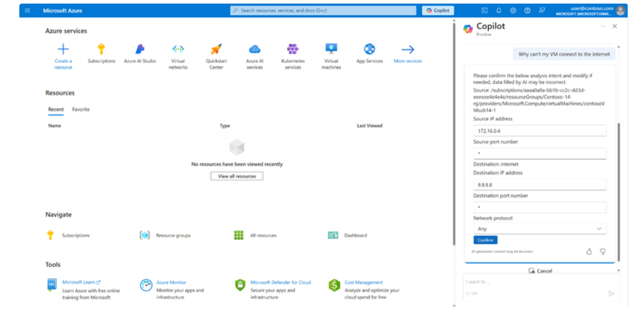
ML & AI & IOT Updates
Introducing Copilot in Azure for Networking
It acts as:
Cloud Networking Specialist by quickly answering questions about Azure networking services, providing product guidance, and configuration suggestions.
Cloud Network Architect by helping select the right network services, architectures, and patterns to connect, secure, and scale your workloads in Azure.
Cloud Network Engineer by helping diagnose and troubleshoot network connectivity issues with step-by-step guidance.

Slide 72
DevOps & IaC & Automation

Slide 73
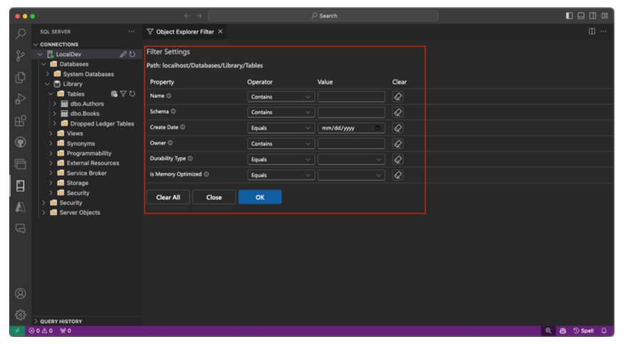
DevOps & IaC & Automation
Introducing the enhanced MSSQL Extension for Visual Studio Code
The MSSQL extension for Visual Studio Code is designed to support developers in building applications that use Azure SQL (including Azure SQL Database, Azure SQL Managed Instance, and SQL Server on Azure VMs), SQL Database in Fabric (Preview) or SQL Server as backend databases. With a comprehensive suite of features for connecting to databases, designing and managing database schemas, exploring database objects, executing queries, and visualizing query plans, this extension transforms the SQL development experience within VS Code.
PP: Empowering teams with new features in MS Dev Box
MS announced a new features in Dev Box that make it easier to configure task-based workstations for development teams and enhance project guardrails.
Cloud-based development environment for teams
Team customizations: Dev team leads can create project-based configurations for their entire team, with the tools, packages and settings in a single config file. (Preview)
Run-as-user support for team customizations enable team leads to execute as-user customizations for more ready-to-code dev boxes.
Imaging: Dev team leads can now convert team customizations into images, reducing provisioning time for new dev boxes, removing the need for custom image pipelines, and enabling automatic upstream OS updates. (Preview)
Dev Box customizations and imaging now support secrets and variables, enabling teams to reuse centralized secrets stored in Azure Key Vault, private repos, or private artifact servers, and work more securely.
Built for enterprise trust
Project Policy. IT Admins can set up guardrails around resources that projects can and cannot access, such as images, SKUs, and network connections. (Preview)

Slide 74
DevOps & IaC & Automation
Public Preview: Nunit support in Microsoft Playwright Testing
MS announced that Microsoft Playwright Testing supports the NUnit test runner. This feature is now in preview. C# developers can now seamlessly run NUnit-based tests with Microsoft Playwright Testing to streamline continuous integration (CI) workflows with a unified dashboard and scalable cloud browsers. NUnit support enables C# developers to accelerate build pipelines by running more tests in parallel, improve test coverage by running across multiple OS-browser combinations, and troubleshoot efficiently with rich reporting that consolidates all results and artifacts in a unified portal.
Public Preview: Azure Deployment Environments updates:
Enhanced integration with Azure Developer CLI (azd) now supports the extensibility model in Azure Deployment Environments: Developers can easily use environment templates in any Infrastructure-as-code (IaC) framework of their choice and leverage intuitive azd commands to deploy their code onto that infrastructure. (Preview)
Force-deletion support: Developers and project admins can now force-delete an environment when the environment is in a failed state or the backing IaC template is no longer available. (Preview)
Support for pre-and post-deployment customization and delete scripts: Platform engineers and dev teams can now configure their environment definitions to invoke custom scripts before or after deployment, along with delete scripts that execute alongside the environment deployments, unlocking new use cases. (Preview)
Private networks for runner: Platform engineers can configure a private network for a compute runner when performing environment deployments, enabling them to control the runner’s network connectivity, using firewall rules, for example, when interacting with internal systems and data. (Preview)

Slide 75
DevOps & IaC & Automation
Azure API Management Policy Toolkit
MS announced the early release of the Azure API Management Policy Toolkit, a set of libraries and tools designed to change how developers work with API Management policies, making policy management more approachable, testable, and efficient for developers.

Slide 76
Information

Slide 77
Information
Azure Times GitHub Repo

Slide 78
Questions

